Slide 1


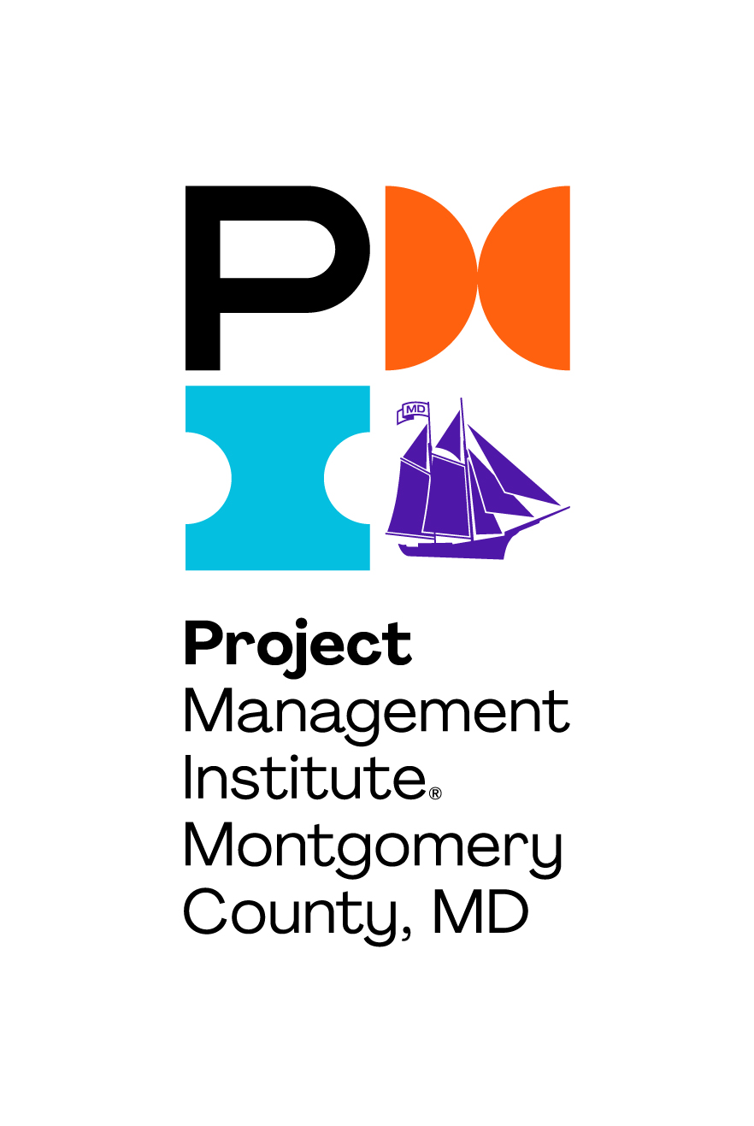
WELCOME TO THE PMI MONTGOMERY COUNTY CHAPTER’S OCTOBER MONTHLY DINNER & VIRTUAL MEETING

Slide 2

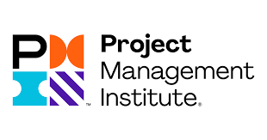
Chapter News & Notes
Let’s Try this Again!!
Election Nominations will begin tomorrow to become a member of the PMI Montgomery County Chapter Board of Officers Team!
5-6 Hrs/Month Requested. Free PDUs, The ability to improve the chapter and a whole lot of fun!

Slide 3
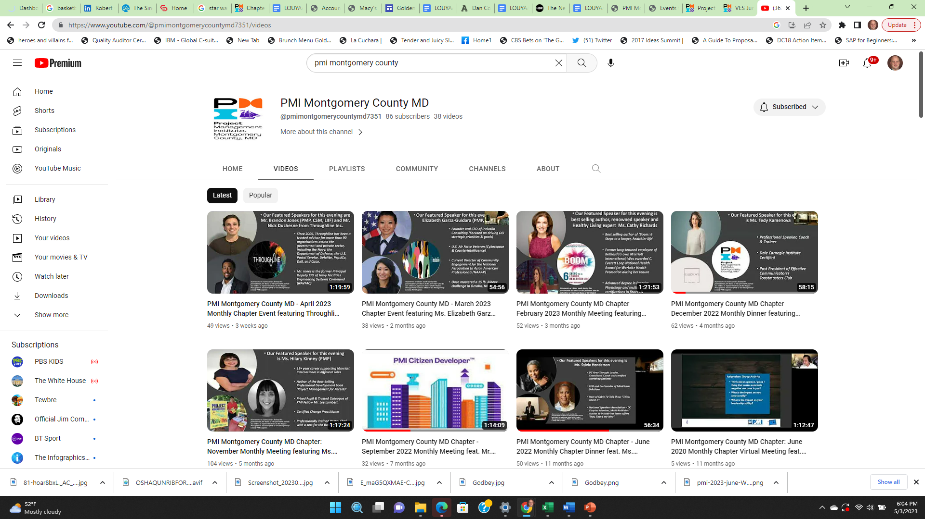
Need PDUs??
Since the start of the Pandemic, 95% of our Chapter Events have been uploaded to our Chapter YouTube Channel
Watch/Listen to a meeting you missed and self-report your 1.0 PDU
(Claim Code in Video Description)

Slide 4


Next Meeting - November
2023 Chapter Member Appreciation Dinner!
Wednesday, November 1st
6pm – 9pm
1.0 PDU – Power Skills
FREE for Valid Members!
Registration Opening this coming Monday 9 October 2023 – Register Early! *Must be Registered to attend*
Buffet-Style Dining Experience
FEATURING THE RETURN TO THE PMI-MC STAGE OF MR. CARL PRITCHARD!
Presentation: Did you hear the one About? – The Art of Storytelling
Holiday Food Drive At Lobby
Entrance –
Bring a few canned/dry goods in
exchange for raffle tickets

Slide 5



December Monthly Meeting
$15 Holiday Special
Wednesday, December 6th
6:45 – 9:00 pm
1.0 PDU – Power Skills
We welcome one of the 50 PMI 2023 Future 50 Recipients
Ms. Krystal Brady (DASSM, DAVSC, PMP) to
the PMI-MC Stage
Presentation Topic: Disciplined Agile at Work (A Benchmarking Study)
Holiday Toy Drive At Lobby
Entrance –
Bring a toy in exchange for Raffle
Ticket!

Slide 6

PMI Montgomery County Toastmasters Group
We meet on the 2nd and 4th Wednesday of the month on Zoom, and the 3rd Wednesday of the month in person.
Davis Library - In-Person Meetings 3rd Wednesdays6400 Democracy Blvd Bethesda, MD 20817
Next Meeting: Wednesday, October 11th (virtual via Zoom) 7pm – 8:30pm
Resume your prior Toastmasters work or start a new Journey!

Slide 7
PMI Montgomery County Sister Chapter Events
UPCOMING EVENTS
Thursday, October 12th: PMIWDC: October 2023 Chapter Meeting In-Person @ Noblis Inc. HQ in Reston, VA. Dual Presentation – Ms. Mignon Edorh (Success Stories from a career at NASA) & Mr. Frank DiBartolomeo (Presentation Skills) w/ Dinner, Drink Ticket $20/$30
Wednesday, October 11th: PMI-Silver Spring October Meeting. Doubletree Hotel
Featured Presentation – Mr. Hector Del Castillo (How AI is transforming Project Mgmt) - $40/$50 w/ Dinner
Wednesday, October 18th: PMI-Baltimore *Frederick MD Division* - St. Marys University
Featured Presentation – Mr. Carl Pritchard (Back in the Saddle)
$40 w/ Dinner

Slide 8



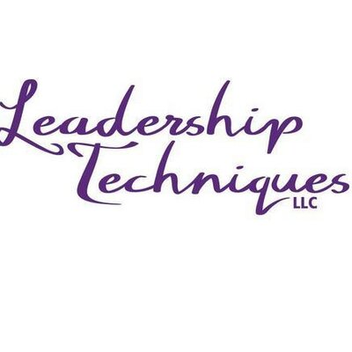




Our Education Partners are still in business and doing Amazing Things!

Slide 9
Ladies and gentlemen, distinguished guests, and esteemed colleagues,
It is with great pleasure that I stand before you today to introduce a true luminary in the world of project management, the one and only Matt Lowy, PMP.
Matt Lowy is not just a seasoned project manager; he is a visionary leader, an advocate for excellence, and a trailblazer in the field of project management. With an illustrious career spanning over two decades, Matt has consistently demonstrated his unwavering commitment to driving success in complex and challenging projects.
Matt's credentials speak volumes about his expertise. He is a certified Project Management Professional (PMP), a distinction earned only by those who have exhibited exceptional knowledge, skills, and experience in the art and science of project management. His dedication to continuous learning and professional development has not only kept him at the forefront of industry trends but has also enabled him to mentor and inspire countless others in their project management journeys.
But Matt's impact goes far beyond the boardroom and project management methodologies. He is a natural leader with an innate ability to motivate and unite teams, fostering a culture of collaboration and innovation. His strategic thinking and problem-solving acumen have consistently yielded outstanding results for organizations across various sectors.
In addition to his impressive professional achievements, Matt Lowy is a passionate advocate for the advancement of project management as a discipline. He has been a tireless contributor to industry forums, conferences, and publications, sharing his wisdom and insights to elevate the entire project management community.
Today, we are privileged to have Matt Lowy, PMP, as our speaker. He will undoubtedly inspire us with his wealth of knowledge, his engaging presentation style, and his unwavering commitment to excellence. So, without further ado, please join me in welcoming the distinguished Matt Lowy, PMP, to the stage. Prepare to be inspired and enlightened as we embark on a journey into the world of project management excellence with one of its most illustrious champions.

Slide 10

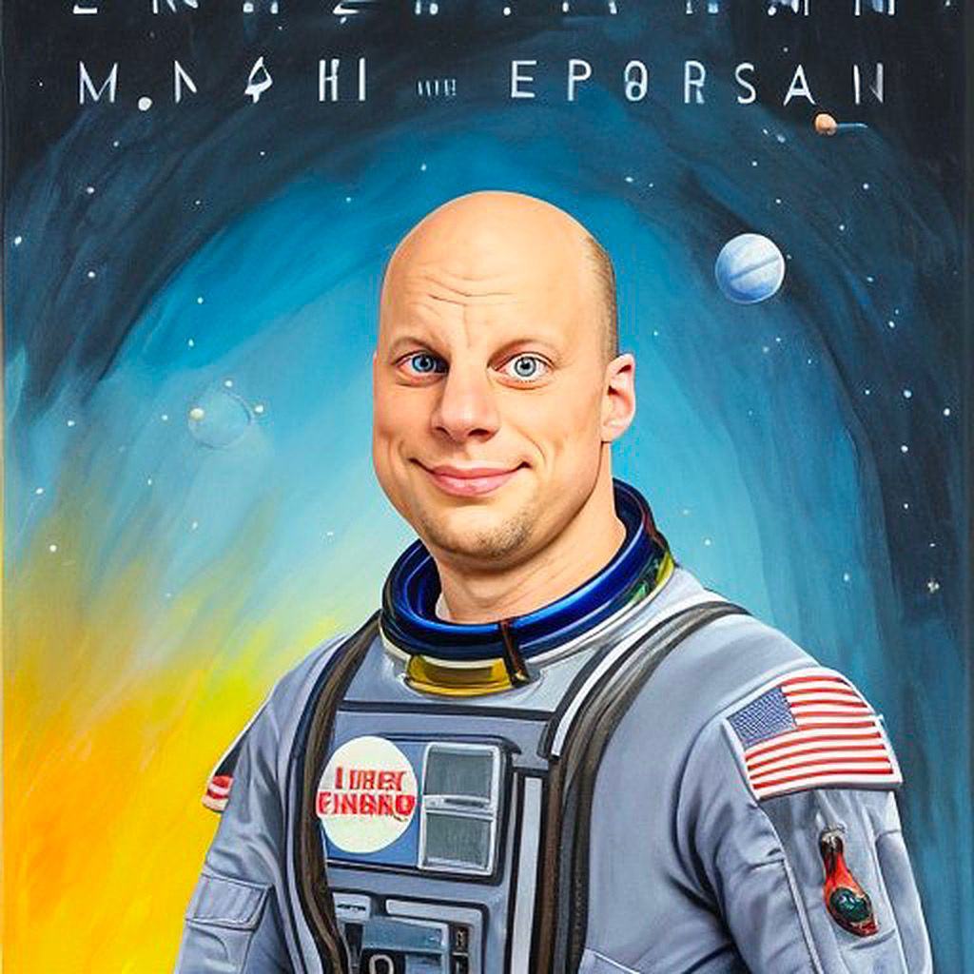

Our Featured Speaker for this evening is Mr. Matt Lowy (Ignore the letters after the name)
Current Chapter Vice President of Membership
Completed a few degrees and handful of certifications in the 2010s
Is proud to announce he is very AI-Curious!
Statements or claims made during this presentation are those of the presenter and do not reflect or represent those of the Project Management Institute (PMI) or the Montgomery County PMI Chapter.

Slide 11



How AI can be a Complement to Project Management
Mr. Matt Lowy
4 October 2023
For PMI MONTGOMERY COUNTY MD CHAPTER

Slide 12
Presentation Abstract….
In today’s rapidly evolving business landscape, effective project management is more critical than ever. Projects are becoming increasingly complex, with tighter timelines and stricter budgets, necessitating innovative approaches to ensure success. Artificial Intelligence (AI) has emerged as a powerful tool that can complement traditional project management methodologies and enhance their effectiveness.
This presentation explores the symbiotic relationship between AI and project management, shedding light on how AI can be seamlessly integrated into project management practices to optimize processes, improve decision-making, and drive project success.
We will delve into various aspects of this synergy, including:
Predictive Analytics: AI-powered algorithms can analyze historical project data to forecast potential risks, resource requirements, and project completion times. This enables project managers to make data-driven decisions and allocate resources more efficiently.
Automated Task Management: AI-driven task automation can streamline routine project management tasks, allowing project managers to focus on strategic activities and creative problem-solving.
Intelligent Resource Allocation: AI can analyze team members’ skills, availability, and workload to suggest optimal resource allocations, ensuring that projects are staffed with the right expertise at the right time.
Real-time Monitoring: AI-powered dashboards provide real-time insights into project progress, helping project managers identify bottlenecks and areas requiring immediate attention.
Natural Language Processing (NLP): NLP can facilitate better communication and collaboration within project teams by extracting valuable insights from project-related documents, emails, and chats.
Risk Management: AI can identify potential risks and propose mitigation strategies, helping project managers proactively address issues before they escalate.
This presentation will showcase real-world examples of organizations successfully integrating AI into their project management practices, resulting in improved efficiency, cost savings, and overall project outcomes. Moreover, we will discuss the ethical considerations and challenges associated with AI implementation in project management and strategies for overcoming them.
By the end of this session, attendees will have a comprehensive understanding of how AI can be a valuable complement to project management, helping organizations adapt to the dynamic nature of today’s projects and drive better project outcomes. Join us in exploring the future of project management powered by AI.

Slide 13
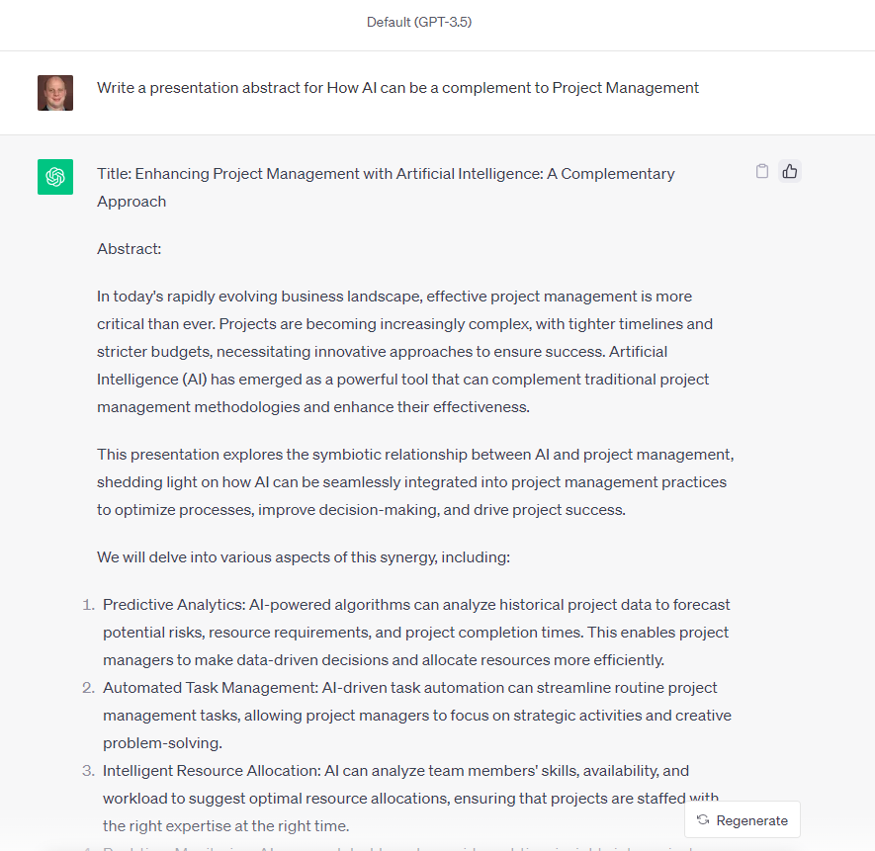
Presentation Abstract….
In today’s rapidly evolving business landscape, effective project management is more critical than ever. Projects are becoming increasingly complex, with tighter timelines and stricter budgets, necessitating innovative approaches to ensure success. Artificial Intelligence (AI) has emerged as a powerful tool that can complement traditional project management methodologies and enhance their effectiveness.
This presentation explores the symbiotic relationship between AI and project management, shedding light on how AI can be seamlessly integrated into project management practices to optimize processes, improve decision-making, and drive project success.
We will delve into various aspects of this synergy, including:
Predictive Analytics: AI-powered algorithms can analyze historical project data to forecast potential risks, resource requirements, and project completion times. This enables project managers to make data-driven decisions and allocate resources more efficiently.
Automated Task Management: AI-driven task automation can streamline routine project management tasks, allowing project managers to focus on strategic activities and creative problem-solving.
Intelligent Resource Allocation: AI can analyze team members’ skills, availability, and workload to suggest optimal resource allocations, ensuring that projects are staffed with the right expertise at the right time.
Real-time Monitoring: AI-powered dashboards provide real-time insights into project progress, helping project managers identify bottlenecks and areas requiring immediate attention.
Natural Language Processing (NLP): NLP can facilitate better communication and collaboration within project teams by extracting valuable insights from project-related documents, emails, and chats.
Risk Management: AI can identify potential risks and propose mitigation strategies, helping project managers proactively address issues before they escalate.
This presentation will showcase real-world examples of organizations successfully integrating AI into their project management practices, resulting in improved efficiency, cost savings, and overall project outcomes. Moreover, we will discuss the ethical considerations and challenges associated with AI implementation in project management and strategies for overcoming them.
By the end of this session, attendees will have a comprehensive understanding of how AI can be a valuable complement to project management, helping organizations adapt to the dynamic nature of today’s projects and drive better project outcomes. Join us in exploring the future of project management powered by AI.

Slide 14
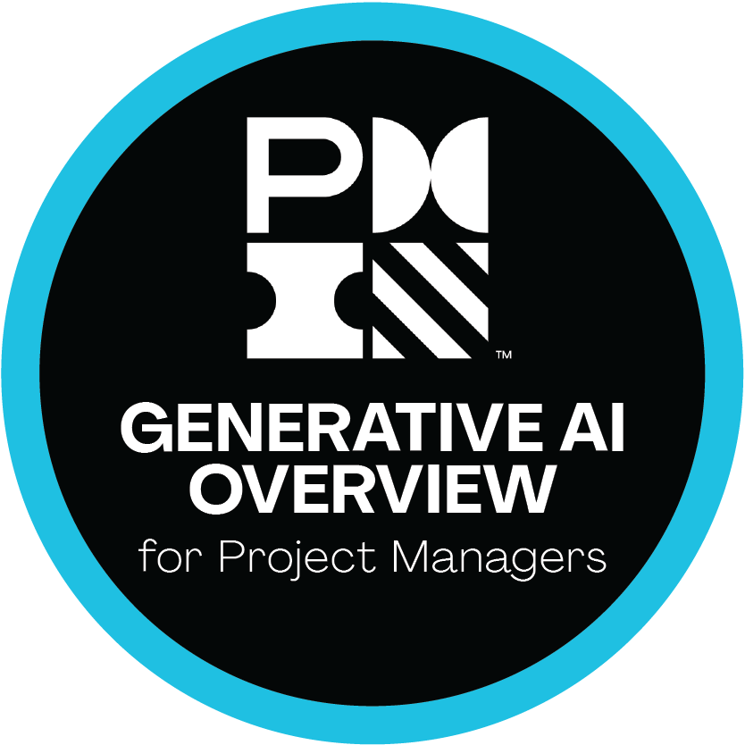
PMI GLOBAL’S COMMITMENT TO AI
In September, PMI launched an introductory online course ‘Generative AI Overview for Project Managers’
5.0 PDUs
15 Question Retention Quiz at conclusion of content (80% and up wins the prize!!)
Committed to Knowledge Center / Center of Excellence going forward

Slide 15
Which is which?
Artificial Intelligence (AI) | Generative Artificial Intelligence (GenAI) | Machine Learning (ML)
The simulation of human intelligence in machines that can perform tasks, learn from experiences, and adapt to new situations. | A type of artificial intelligence that results in new data, such as images, music, text, or code. | Machine learning is a branch of AI and computer science which focuses on the use of data and algorithms to imitate the way that humans learn, gradually improving its accuracy.

Slide 16
When did this Big Boom Happen ?
The OpenAI developed Chat Generative Pre-Trained Transformer (ChaTGPT) launched on November 30th 2022
That was only….. 308 Days Ago!!

Slide 17
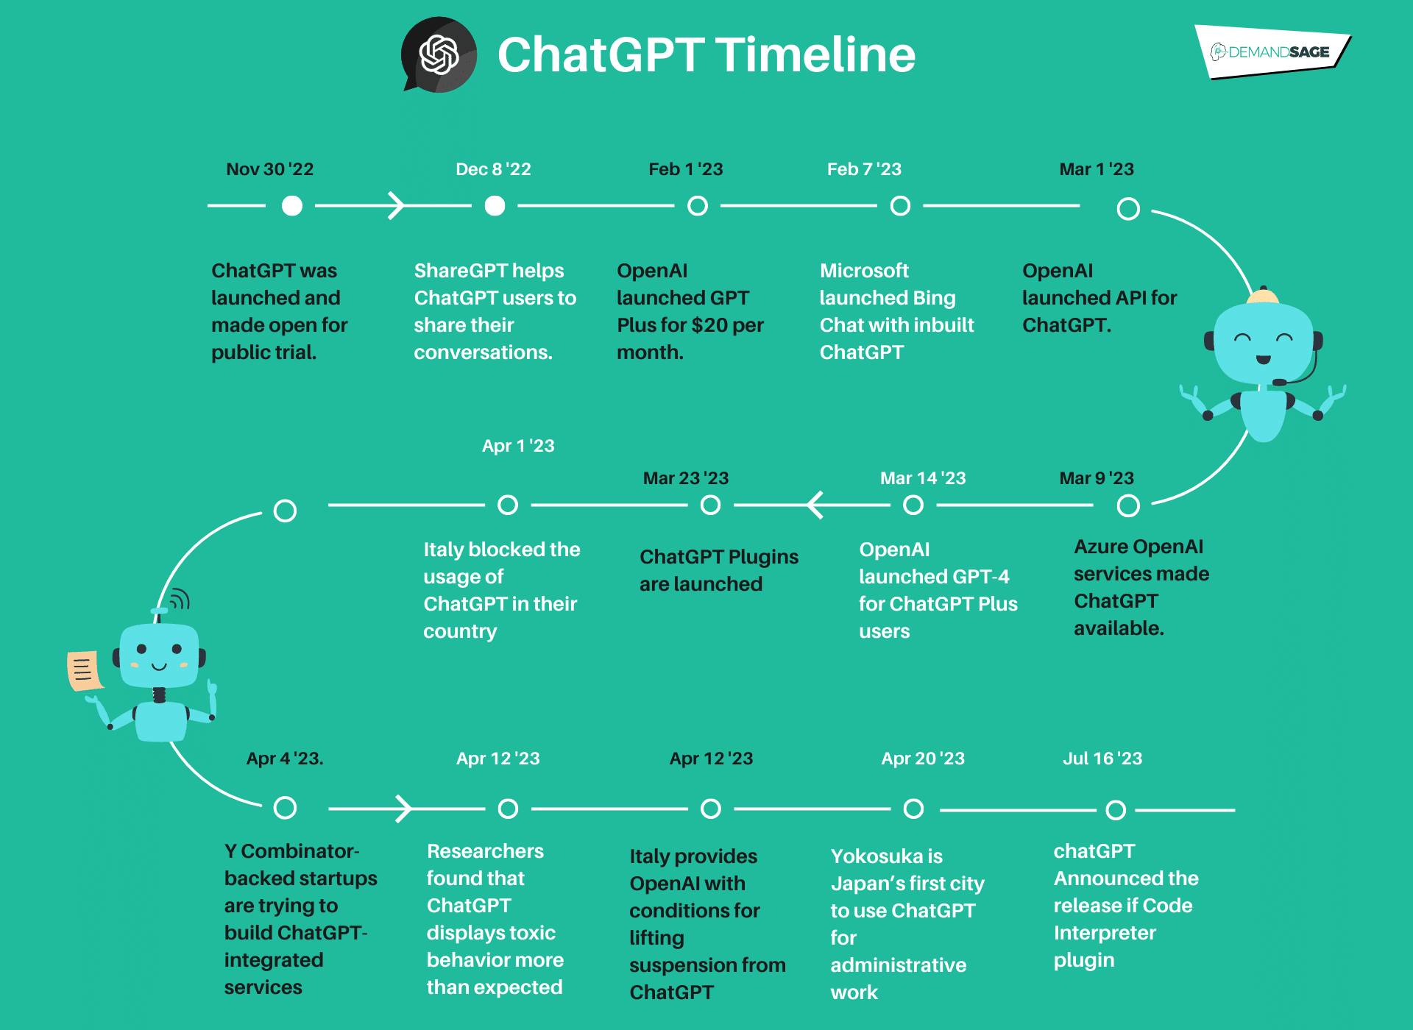
Ref:
Demand
Sage,
2023

Slide 18
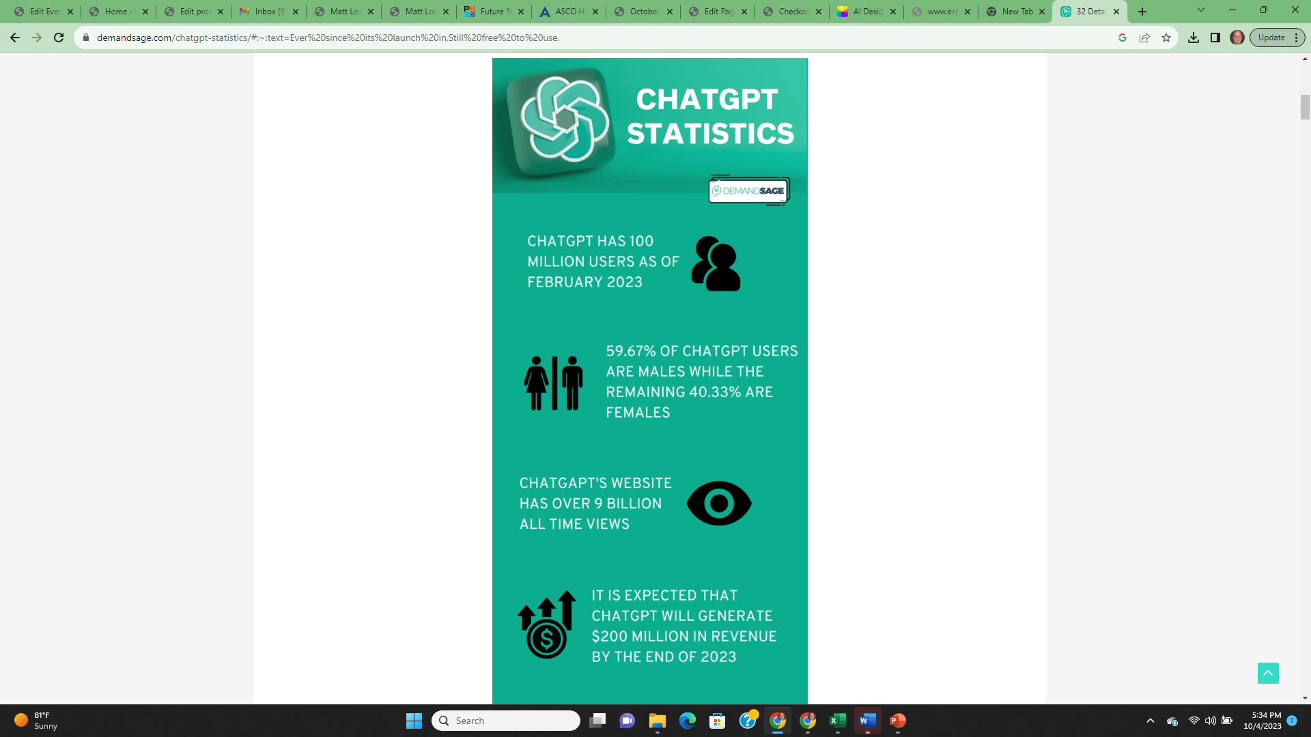
The wonder of 10 months of release!
Ref: Demand Sage, 2023

Slide 19
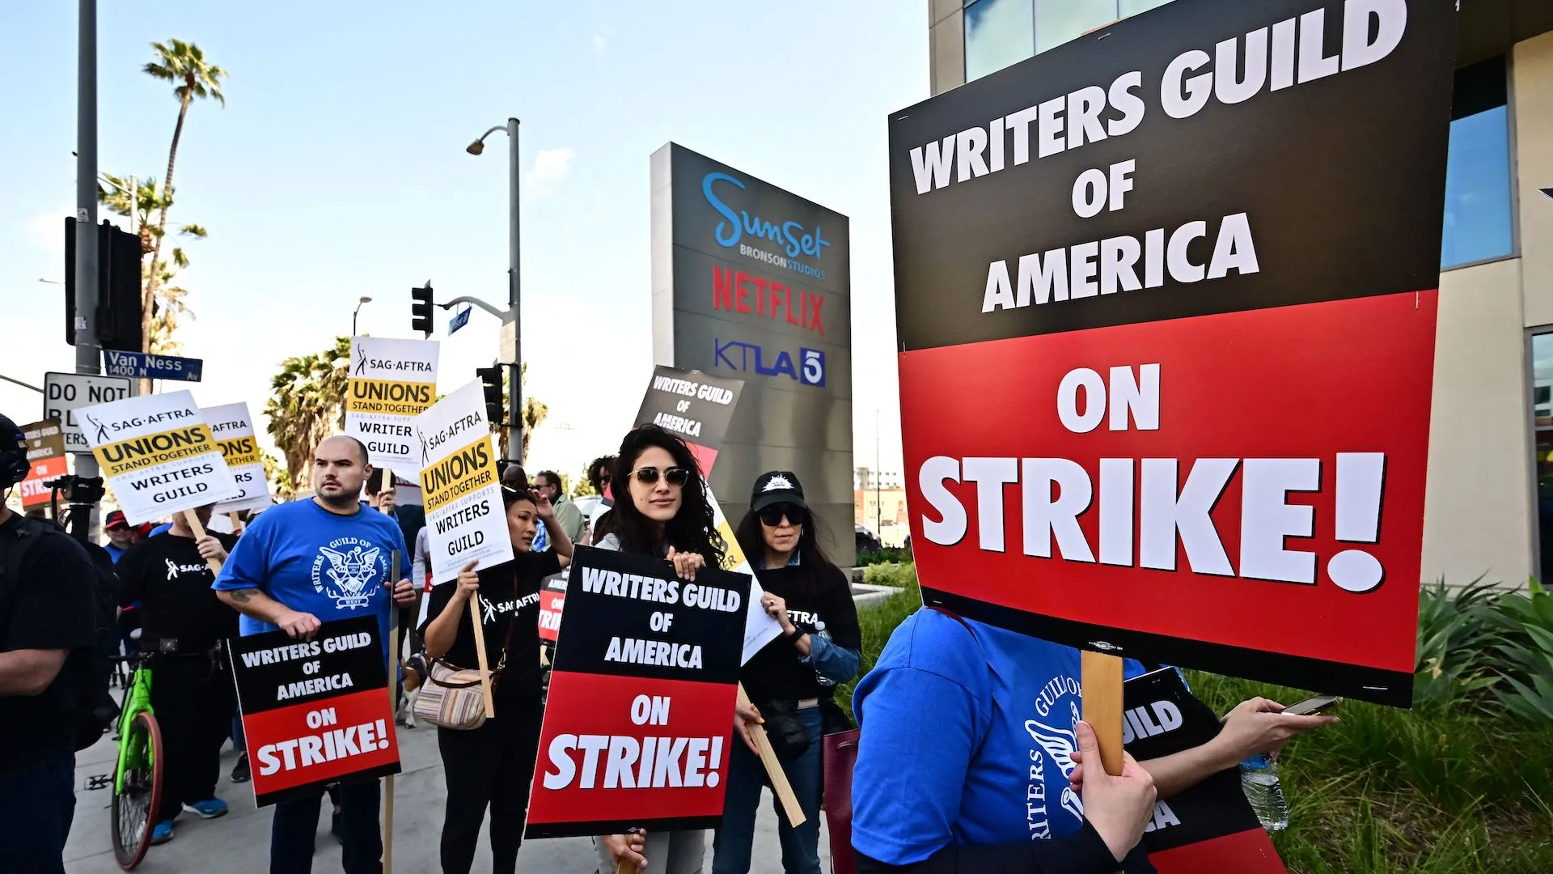

But Oh… the drama it has caused

Slide 20
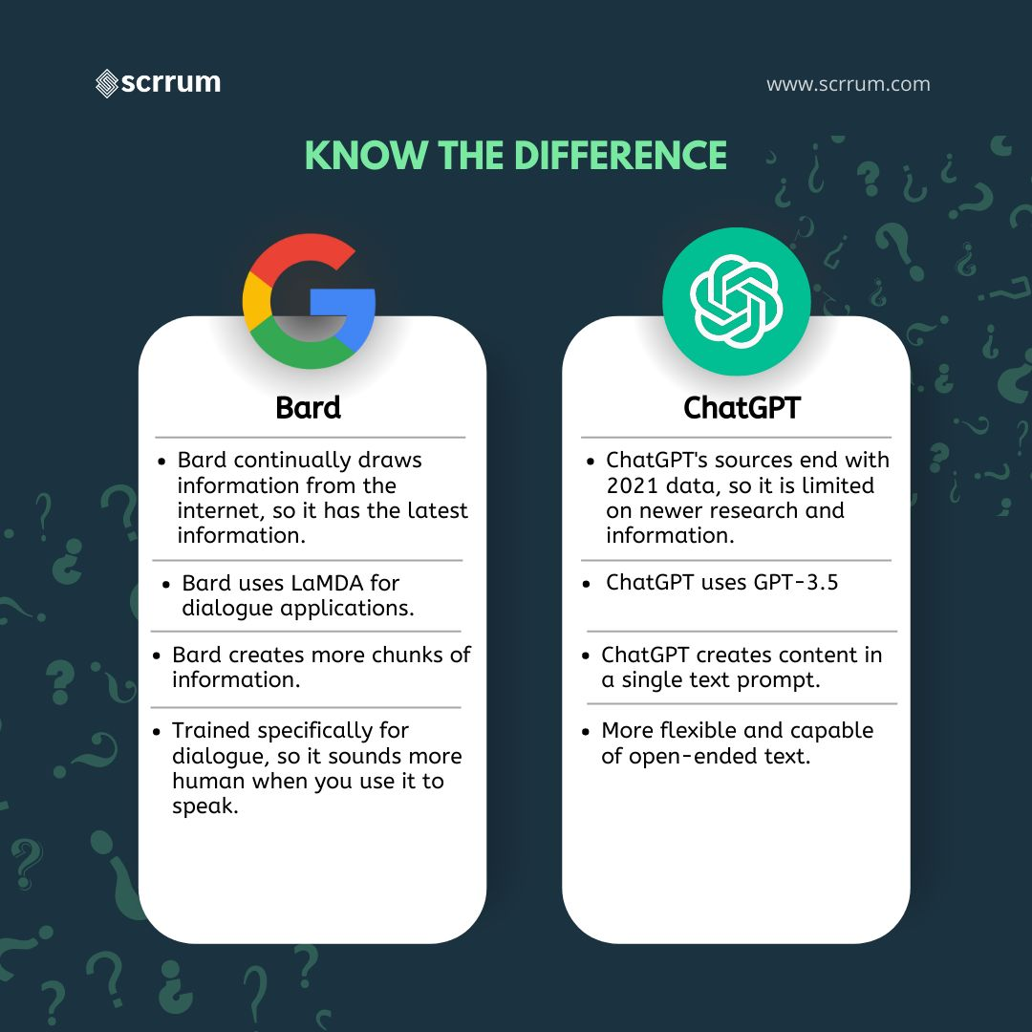
“You didn’t think you’d win… Did You ? “
Google Bard released to the public on March 23rd 2023 as an “Experiment”
Ref:
Scruum, 2023

Slide 21
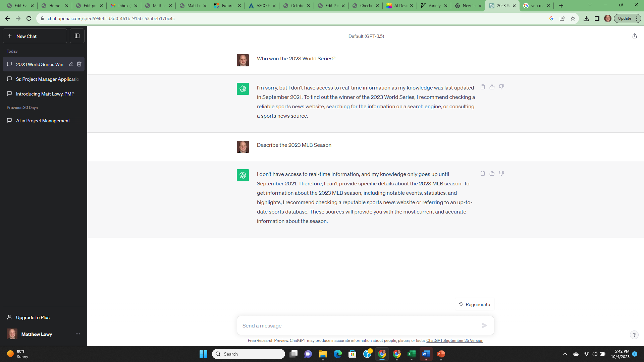
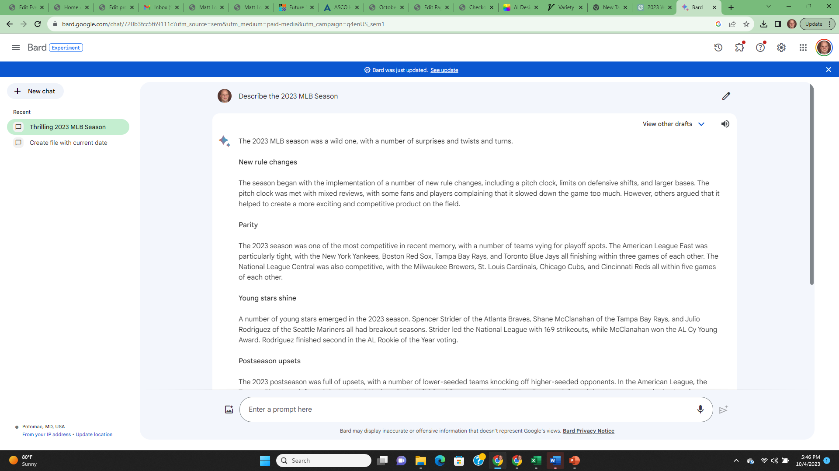
Stuck in 2021!

Slide 22
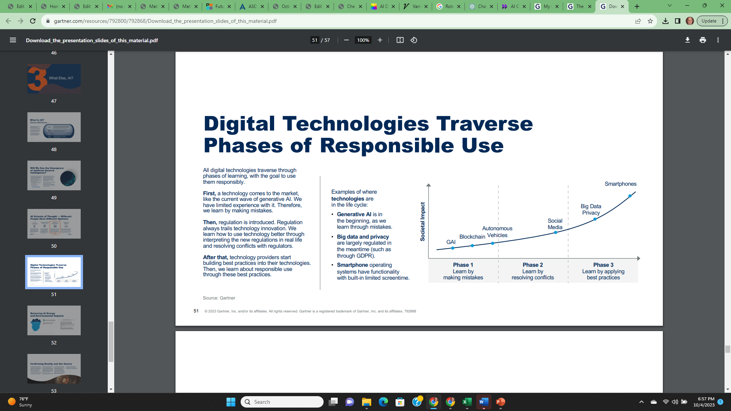

Slide 23
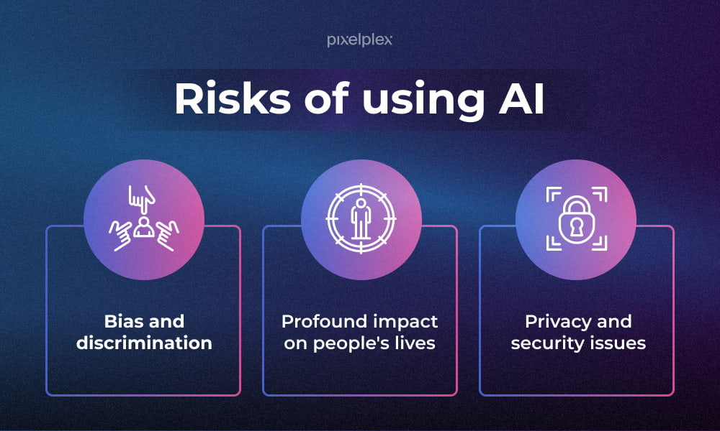
Ref: PixelPlex, 2023

Slide 24
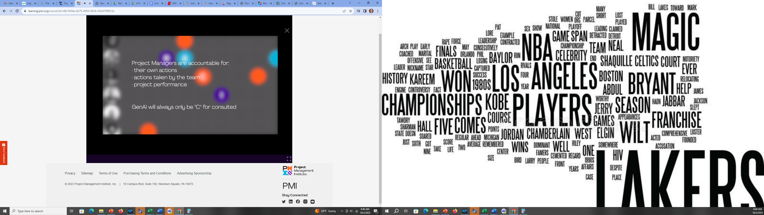
Speaking RASCI, the Project Manager (The Human) remains the ‘A’….For Now
Ref:
PMI, 2023

Slide 25
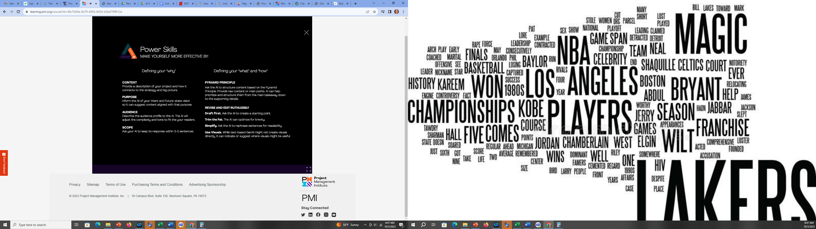

Slide 26
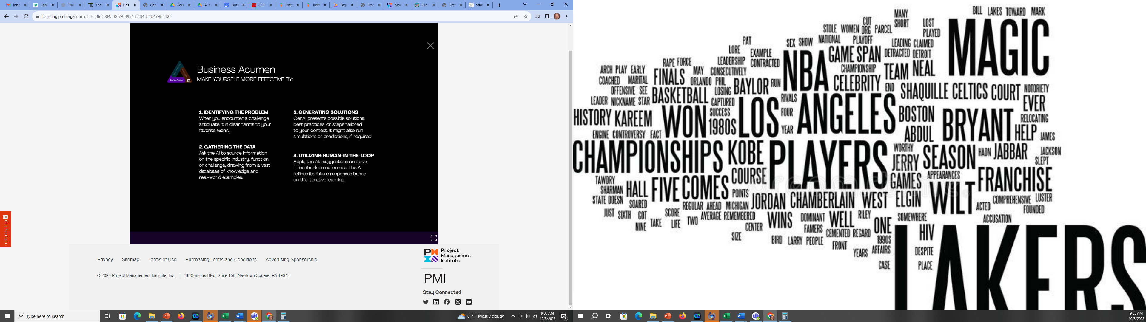

Slide 27


Slide 28
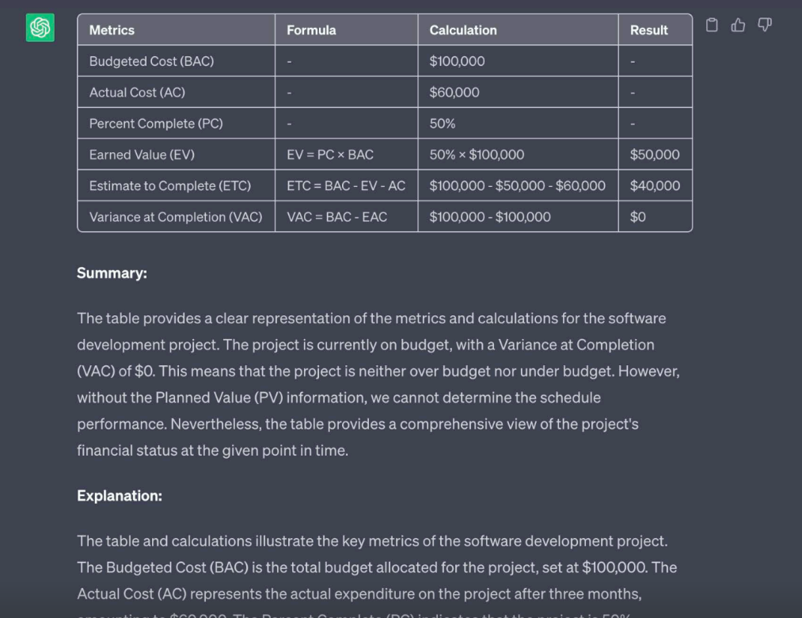
COST BENEFIT ANALYSIS
PROMPT:
A software development project has
a $100K budget and a timeline of 6
months. After 3 months, the actual cost
(AC) is $60K and the project is 50%
complete.
Am I over or under budget? Behind or
ahead of schedule? And what is the
earned value (EV), Estimate to complete
(ETC), and value-added control (VAC)
Show this in a table format and highlight
the explanation in bold.
Source: PMI, 2023

Slide 29
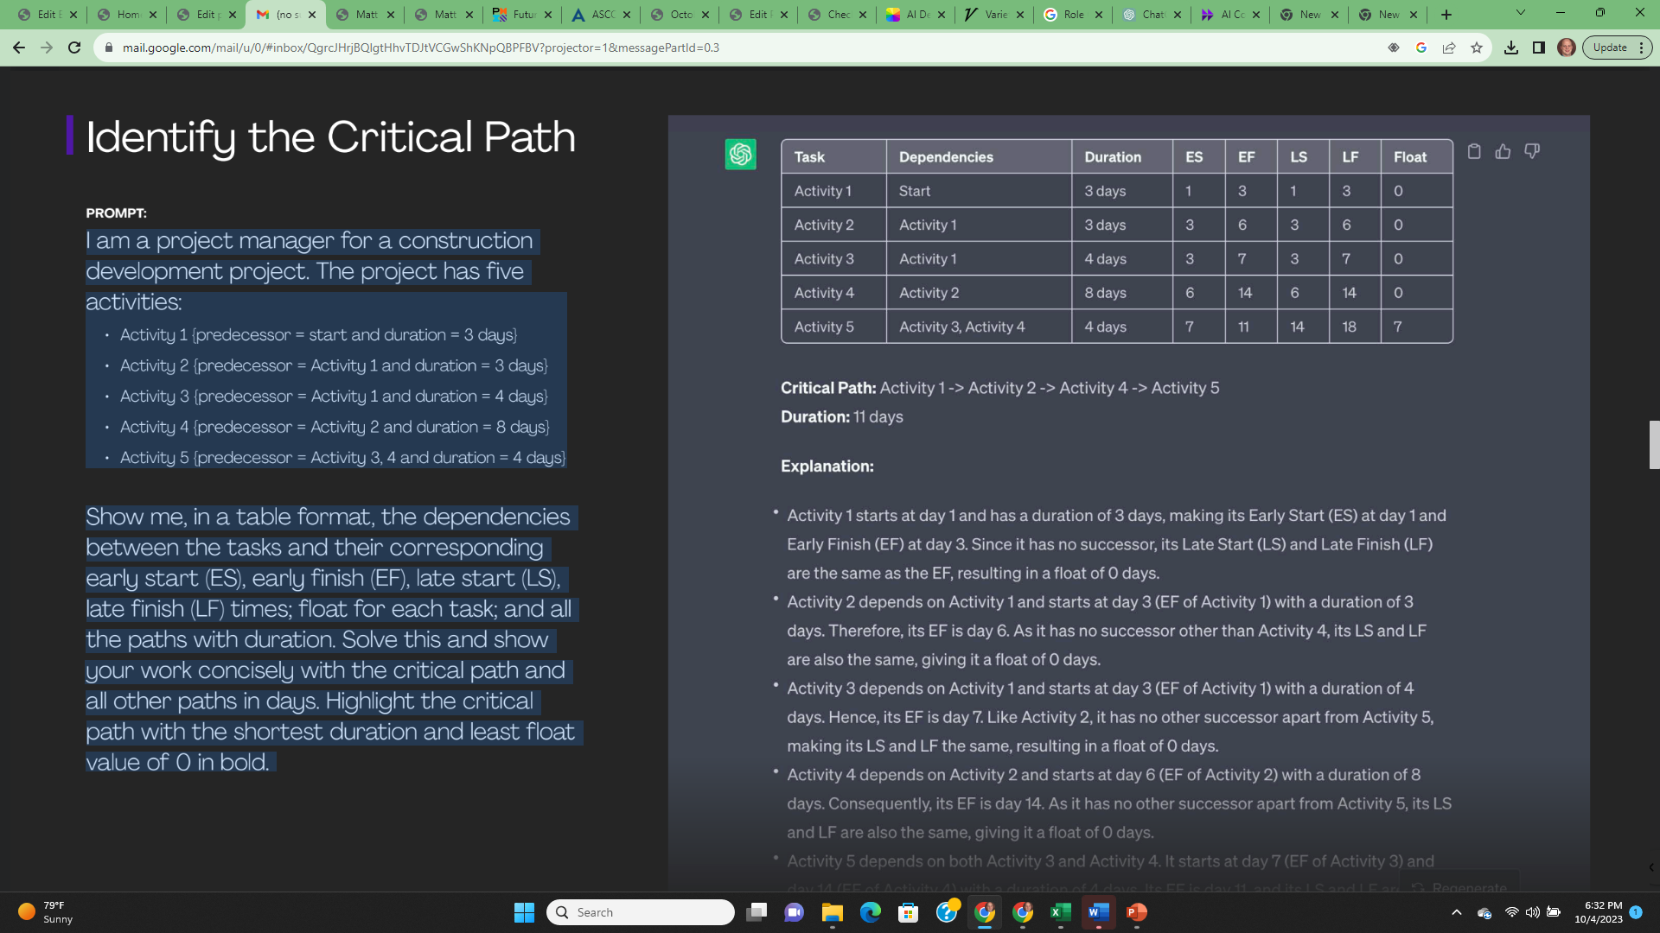
BEHOLD.. THE CRITICAL PATH!
PROMPT:
I am a project manager for a construction
development project. The project has five
activities:
• Activity 1 {predecessor = start and duration = 3 days} • Activity 2 {predecessor = Activity 1 and duration = 3 days} • Activity 3 {predecessor = Activity 1 and duration = 4 days} • Activity 4 {predecessor = Activity 2 and duration = 8 days} • Activity 5 {predecessor = Activity 3, 4 and duration = 4 days}
Show me, in a table format, the dependencies
between the tasks and their corresponding
early start (ES), early finish (EF), late start (LS),
late finish (LF) times; float for each task; and all
the paths with duration. Solve this and show
your work concisely with the critical path and
all other paths in days. Highlight the critical
path with the shortest duration and least float
value of 0 in bold.
Source: PMI, 2023

Slide 30
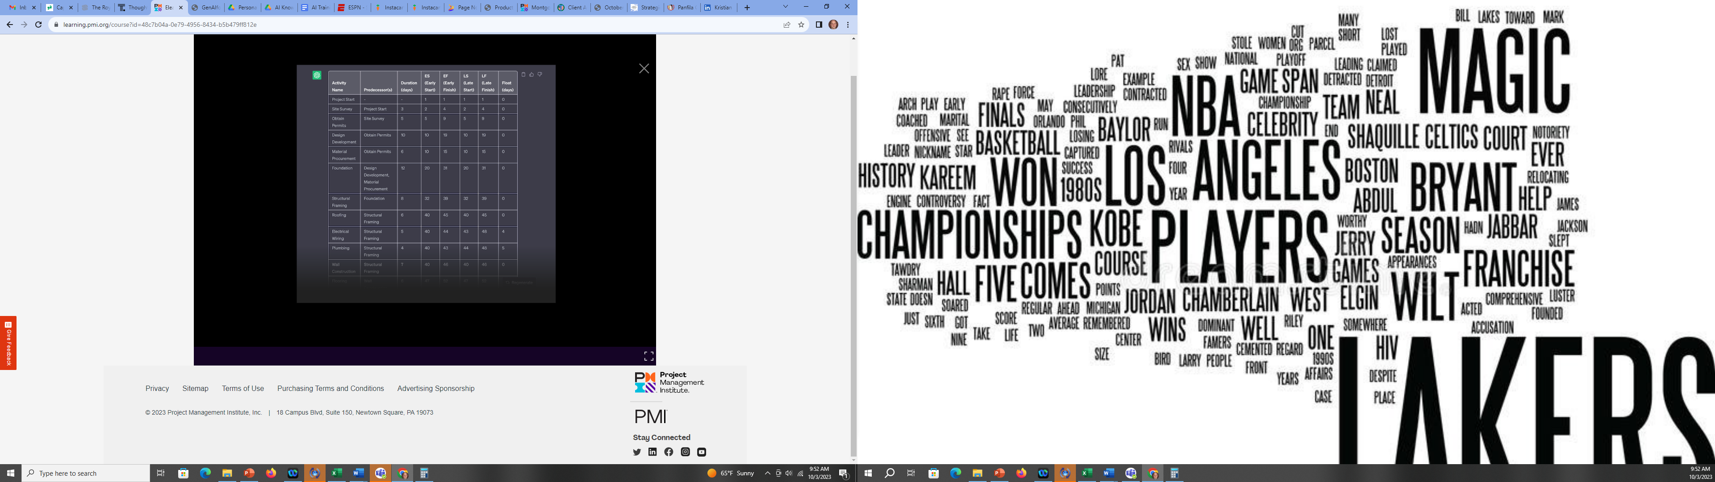
PROJECT SCHEDULE
PROMPT:
With the data from the critical path exercise, create a detailed project schedule with placeholder activity names.
Source: PMI, 2023

Slide 31
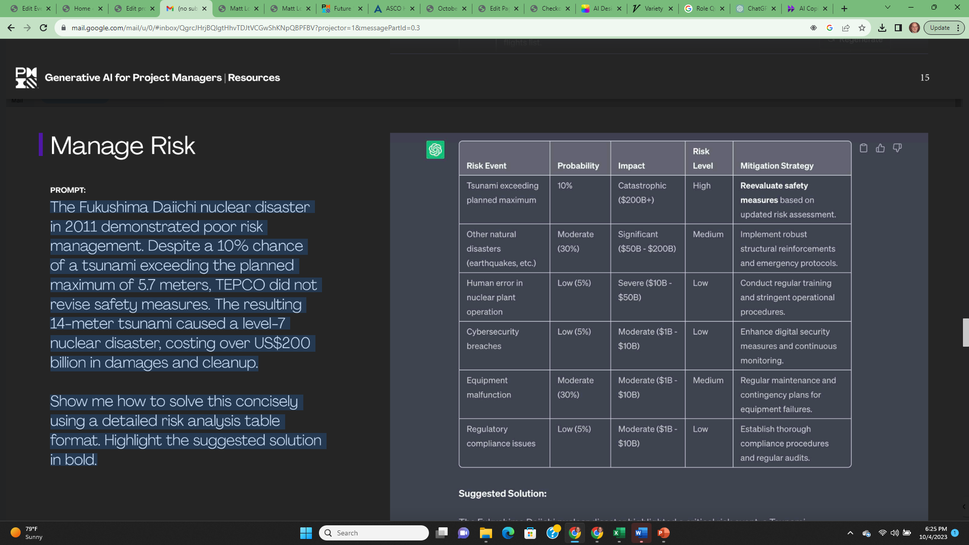
RISK MANAGEMENT
The Fukushima Daiichi nuclear disaster
in 2011 demonstrated poor risk
management. Despite a 10% chance
of a tsunami exceeding the planned
maximum of 5.7 meters, TEPCO did not
revise safety measures. The resulting
14-meter tsunami caused a level-7
nuclear disaster, costing over US$200
billion in damages and cleanup.
Show me how to solve this concisely
using a detailed risk analysis table
format. Highlight the suggested solution
in bold.
Source: PMI, 2023

Slide 32
WHAT YOU PUT IN… YOU SHALL RECEIVE BACK!
In formulating your Generative AI Request, follow the following RQAT model for your request:
ROLE: State the role that you are requesting from
QUESTION: Ask for what you want from the AI
ACTION: State the action that you need the AI to complete
TONE: State the Tone that you want the information back in
Source: Kristian Bainey, 2023

Slide 33
BATTER UP!!
ROLE: As a Contracting Officer
QUESTION: A Request for Proposal is needed for a Professional Services Contract
ACTION: Please provide RFP Template
TONE: with passive guardrails

Slide 34
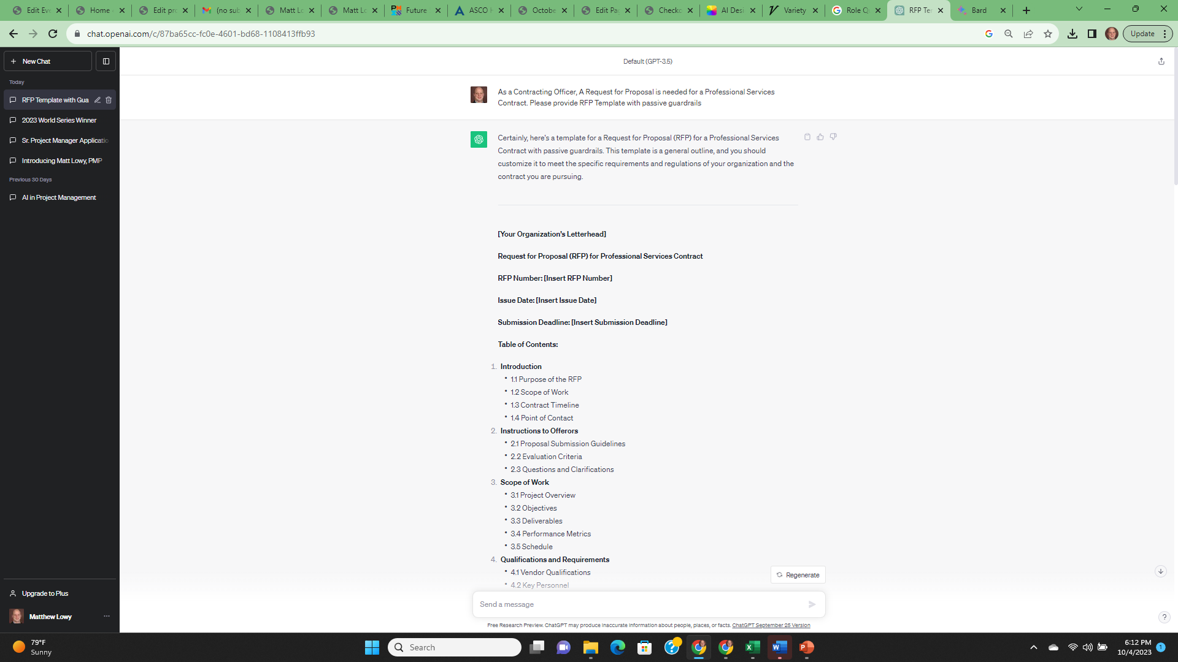
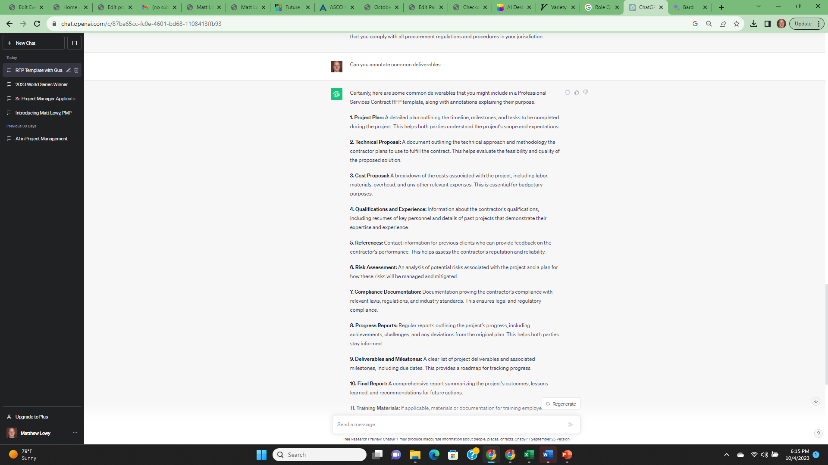

Slide 35
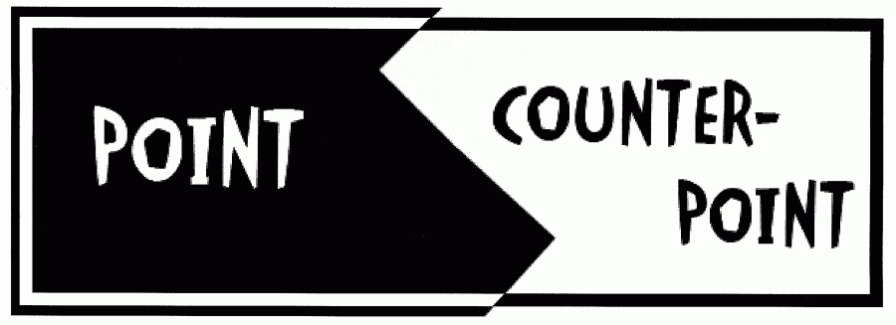
Is my career safe or should I switch?
I believe that the real value of a Project Manager is in the higher level thinking, higher level strategizing, higher level relationship building and support activities to help ensure that the whole strategy gets delivered?
- Laura Barnard, CEO and Founder of PMO Strategies
If Project Planning Artifacts, Project Administration and lower-level decision making is primarily done by AI,
Will the workforce reduce in # of resources due to lack of necessity??

Slide 36
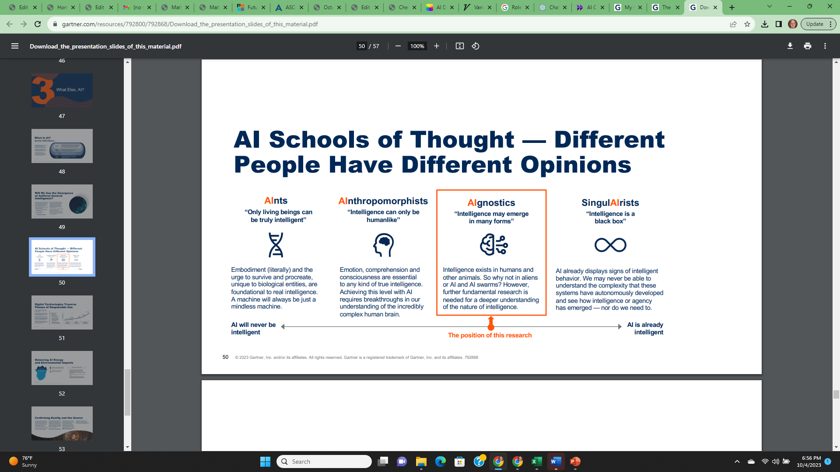

Slide 37
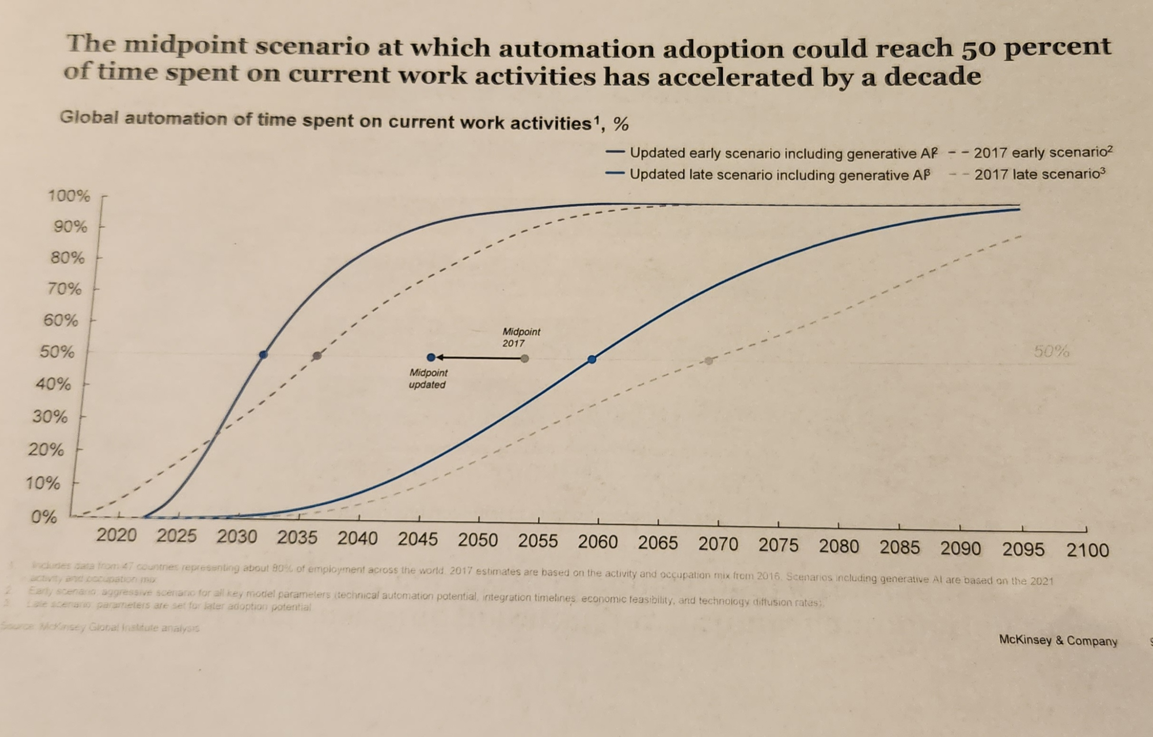
Source: McKenzie & Company, 2023

Slide 38
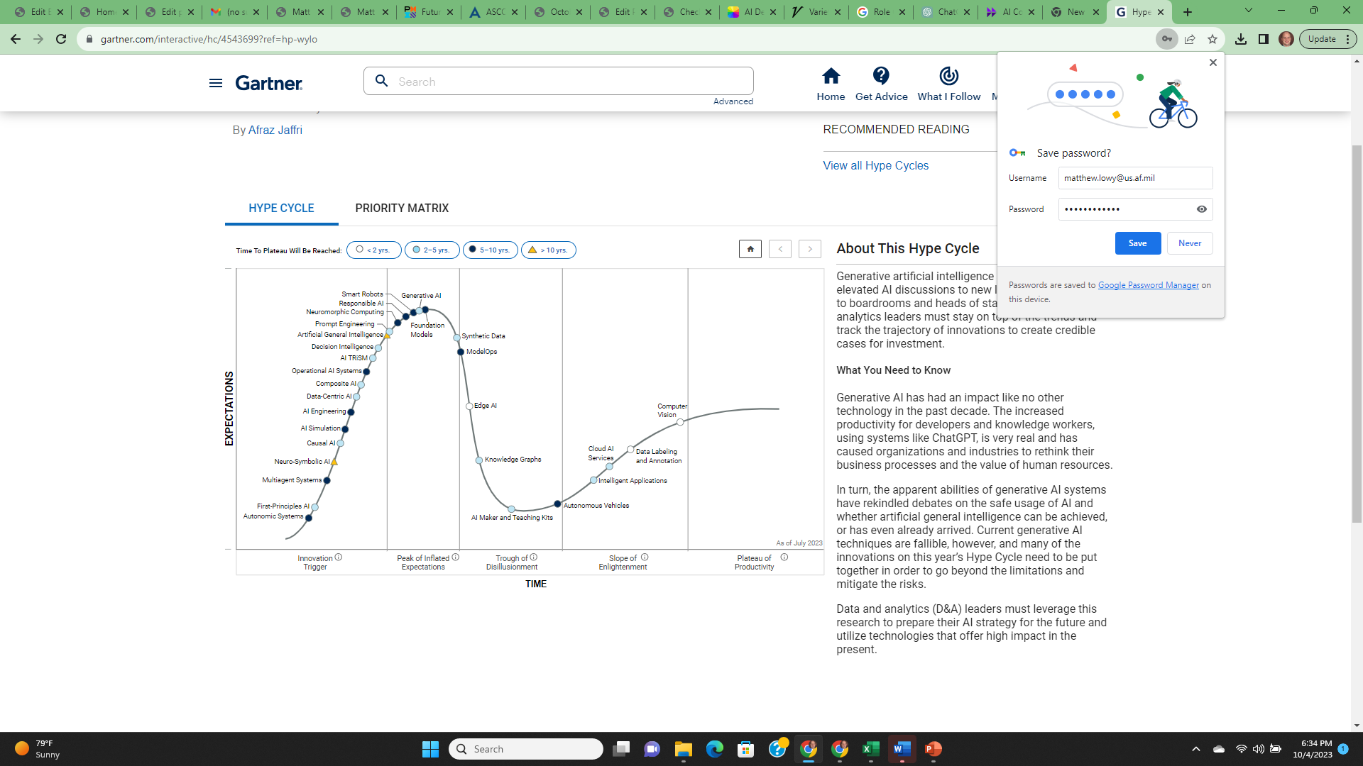
Source: Gartner, 2023

Slide 39
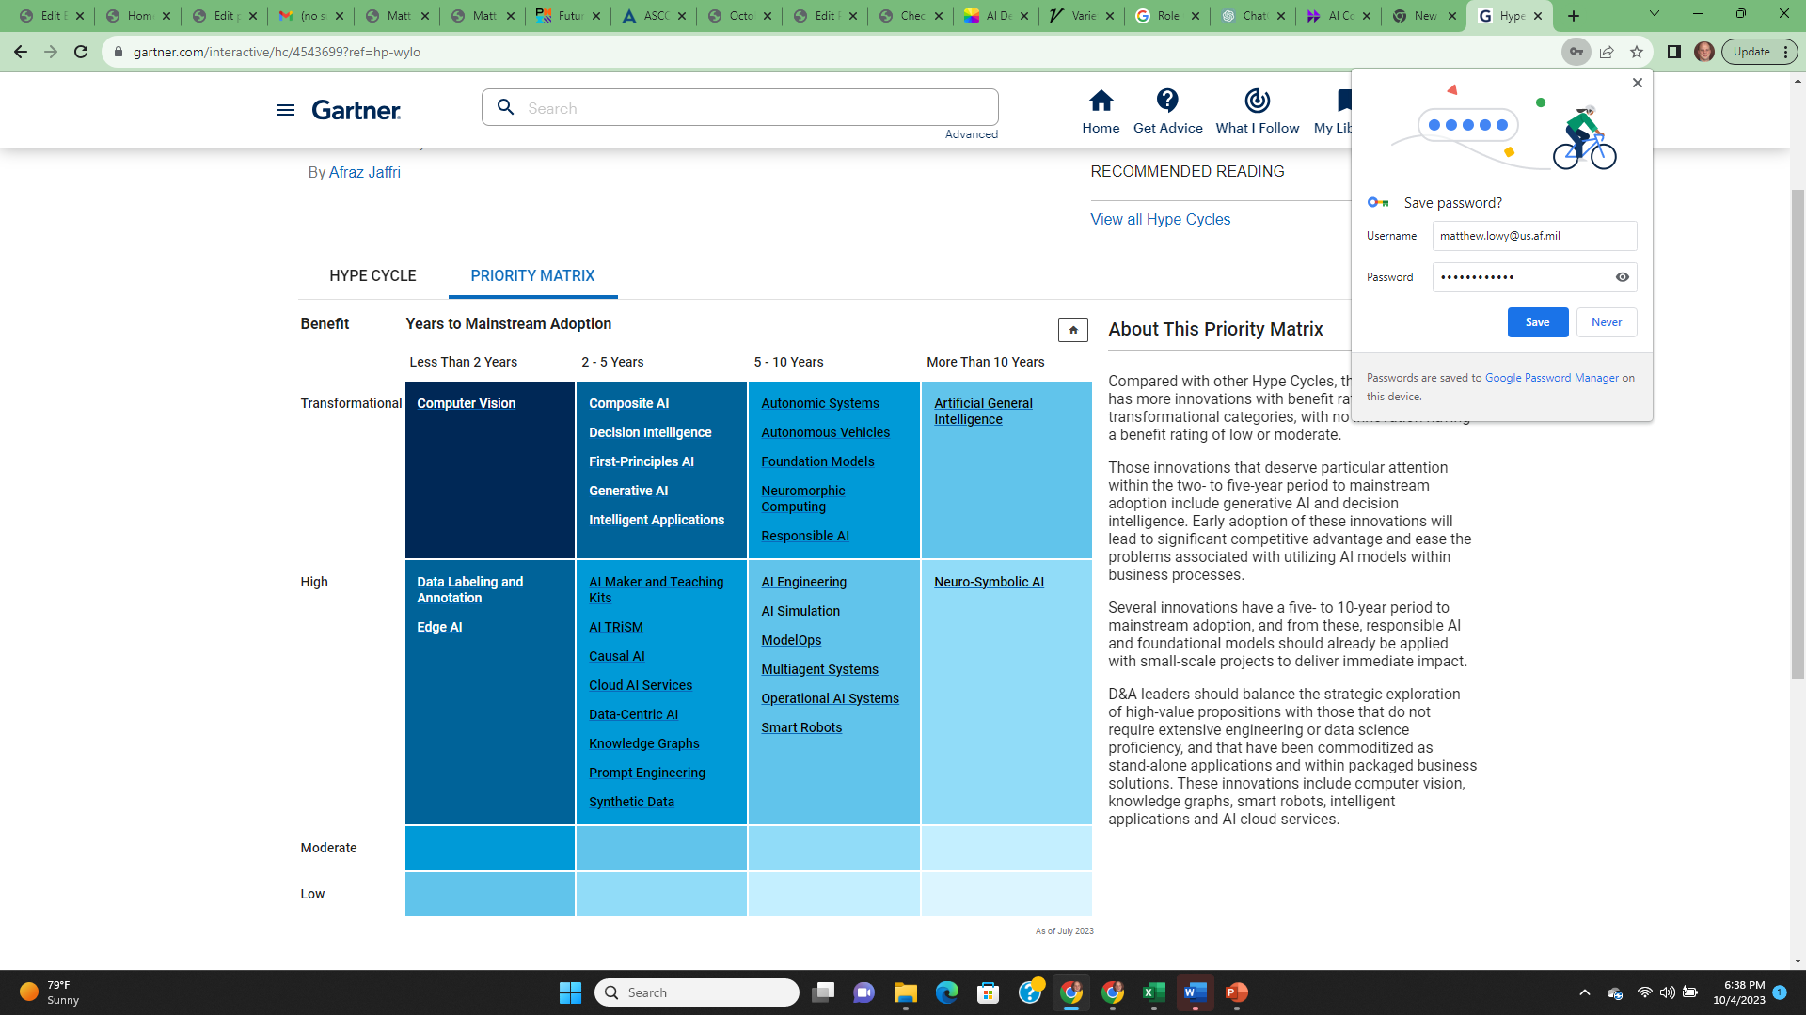
Source: Gartner, 2023

Slide 40
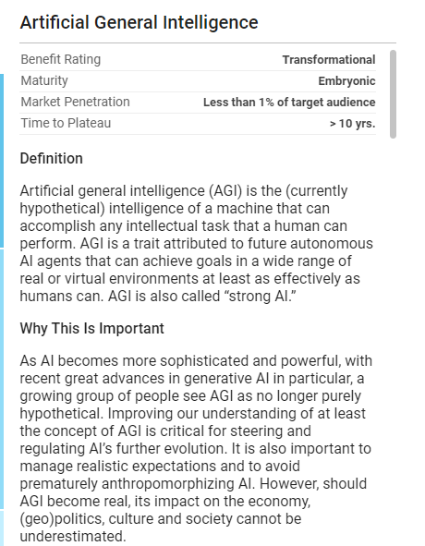
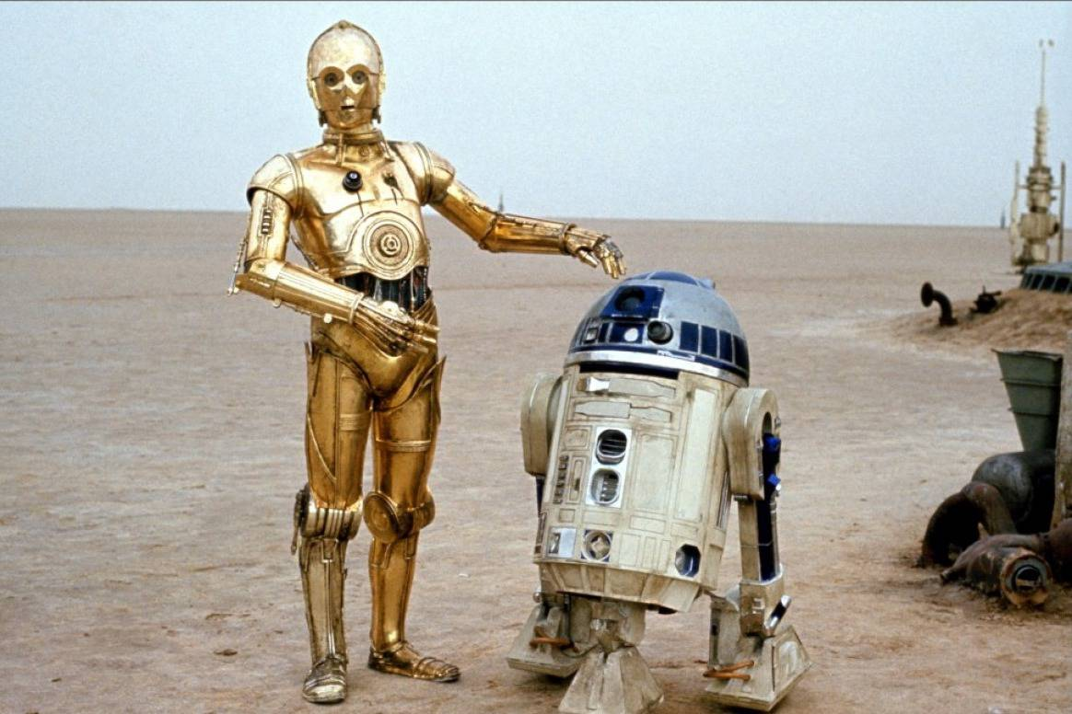
Source: Gartner, 2023

Slide 41
COVER LETTER ASSISTANCE
Write a Cover Letter for a Sr. Project Manager position at Marriott International in Bethesda, MD
[Your Name] [Your Address] [City, State, ZIP Code] [Your Email Address] [Your Phone Number] [Date]
Marriott International, Inc. Attn: Human Resources Department 10400 Fernwood Road Bethesda, MD 20817
Dear Hiring Manager,
I am writing to express my strong interest in the Senior Project Manager position at Marriott International, Inc. as advertised. With a proven track record of successfully leading complex projects and a passion for delivering exceptional results, I am confident that my skills and experience align perfectly with your organization's commitment to excellence and innovation.
Over the past [X years], I have honed my project management expertise in a variety of industries, including [mention relevant industries, e.g., hospitality, real estate]. I have consistently delivered projects on time and within budget while ensuring that they meet or exceed quality standards. My ability to effectively communicate with cross-functional teams and stakeholders, coupled with my dedication to maintaining transparency and accountability throughout the project lifecycle, has consistently contributed to project success.
At my current role as a [Your Current Job Title] at [Your Current Company], I have been responsible for overseeing a diverse portfolio of projects, ranging from [mention examples of projects relevant to the hospitality industry, e.g., hotel renovations, technology implementations, or sustainability initiatives]. I have a strong record of achieving strategic objectives, such as improving operational efficiency, enhancing guest experiences, and driving revenue growth.
In addition to my project management skills, I possess a solid understanding of Marriott International's core values and corporate culture. I am highly motivated to contribute to your organization's continued success and to help uphold the company's reputation as a global leader in the hospitality industry.
Key qualifications and skills that I would bring to this role include:
Project Leadership: Proven ability to lead cross-functional teams and deliver projects within scope, schedule, and budget constraints.
Strategic Planning: Expertise in developing and executing project plans aligned with corporate objectives.
Risk Management: Proficiency in identifying potential risks and implementing mitigation strategies to ensure project success.
Stakeholder Communication: Strong interpersonal and communication skills to collaborate effectively with team members, executives, and external partners.
Technology Proficiency: Familiarity with project management software and tools to streamline project workflows and reporting.
I am excited about the opportunity to join the Marriott International team and contribute to the company's continued growth and success. I am confident that my experience, dedication, and passion for excellence make me a strong fit for this Senior Project Manager role.
Enclosed is my resume, which provides further details about my professional background. I would welcome the opportunity to discuss how my qualifications align with your needs and how I can contribute to the success of Marriott International. Please feel free to contact me at [Your Phone Number] or via email at [Your Email Address] to schedule an interview.
Thank you for considering my application. I look forward to the possibility of becoming a valuable member of the Marriott International team and contributing to the company's ongoing achievements.
Sincerely,
[Your Name]
Source: Open AI, 2023

Slide 42





CALL TO ACTION !!!
Become AI-Curious !
(You don’t have to be an expert but dip a toe in!)

Slide 43
TAKE PMI’S FREE COURSE!!!
5.0 PDUs for Free!
The deal of the Fall Season!

Slide 44
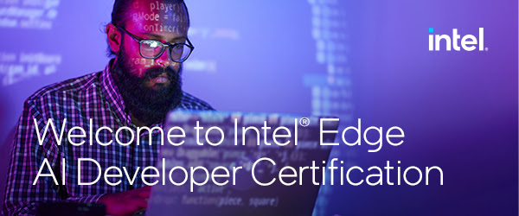

TRAINING & EDUCATION
Intel Edge AI Developer Certification
Coursework & Curriculum: Free
Certification Exams: $99
Multiple Certifications
Certified Artificial Intelligence Engineer (CAIE): $691
Certified Artificial Intelligence Consultant (CAIC): $787
Certified Artificial Intelligence Scientist (CAIS): $894
Certified AI Transformation Leader (CAITL): $2,149
MIT Machine Learning: $2,255
Programs for High Schoolers
Novice for 9th and 10th graders
Advanced for 11th & 12 graders

Slide 45
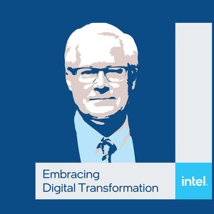
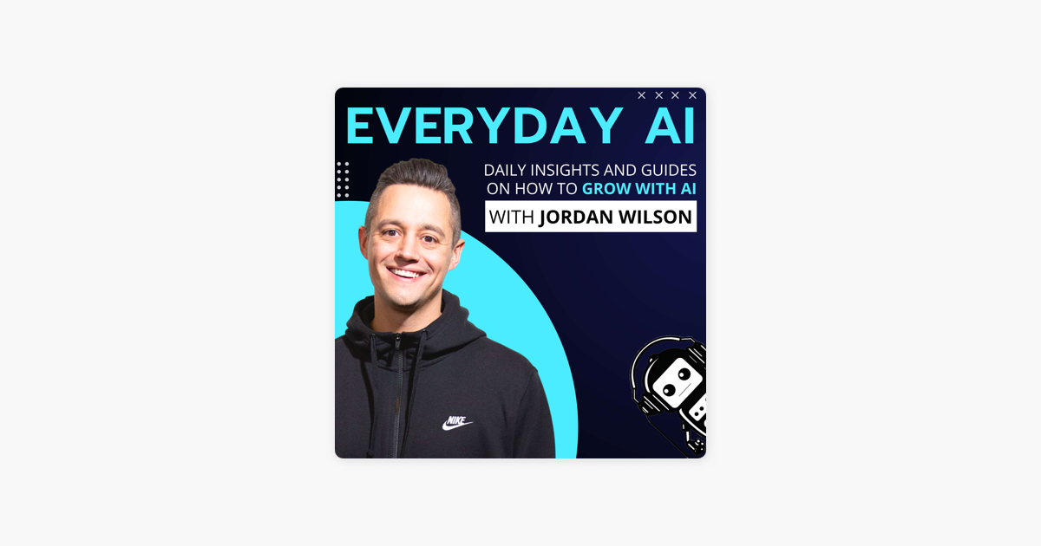
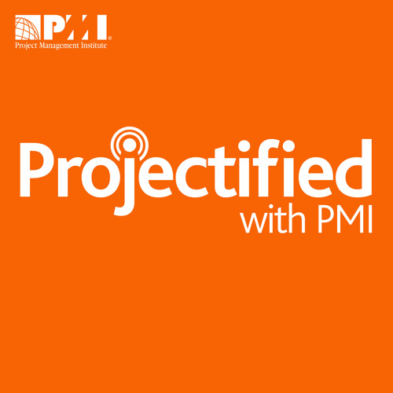
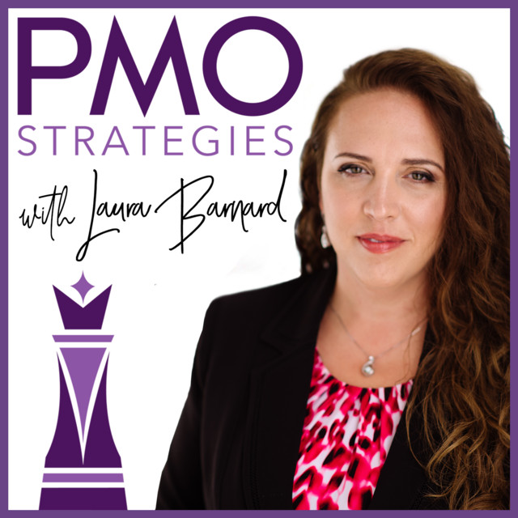
PODCASTS
Embracing Digital Transformation
Host: Darren Pulsipher
Episode#122 – Feb 23: Automation with AI (A full Interview with ChatGPT
Episode #147 – June23:
Generative AI & Automation (Interview w/ Google Bard)
Everyday AI
Host: Jordan Wilson
Episode 106 – Sep 23
Using AI To land a New Career
Episode 83 – Aug 23
Chat GPT Basics
PMI’s Projectified
Host: Steve Hendershot
Aug 23 – Tips for Using Generative AI Tools in Project Management
PMO Strategies
Host: Laura Barnard
Episode 218 – Aug 23
How will AI Affect Project Managers – W/ Scott Ambler
Episode 211 – Jul 23
Critical Thinking, AI And the Future of Project Management w/ Donna Fitzgerald

Slide 46
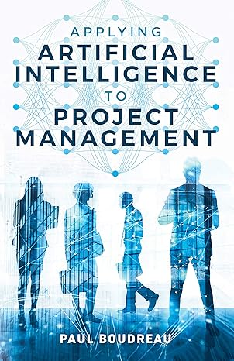
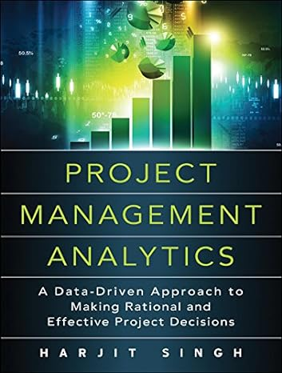
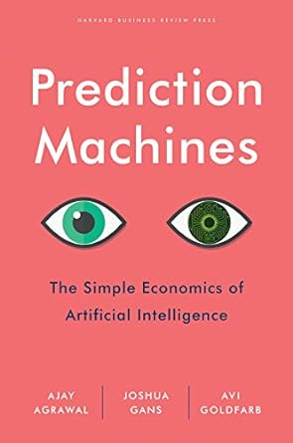
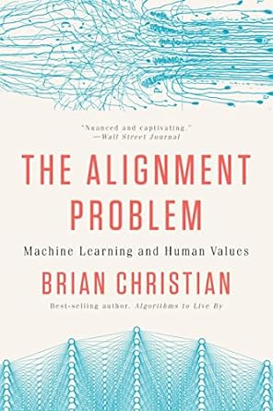
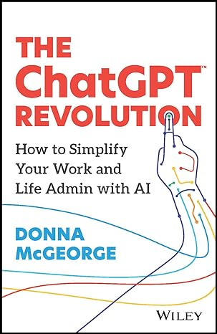
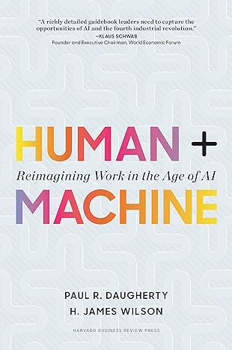
READING LIST
An insightful, fun read that makes every day sense of the value of ChatGPT
$20 – Hardcover
$13 – Kindle
Released in 2019 *Pre-ChatGPT*
Focused on Frameworks & Methodology
Free to Amazon Kindle Unlimited Subscribers
A Masterclass in evidence-based rationale for our project
$50 Amazon Kindle Price
A great read on the policy piece of AI
$10 – Hardcover
$12 – Kindle
Spotlights the risk that comes with AI and how we can learn from technology history
$24 – Hardcover
$13 – Kindle
A great practical guide to a foundational understanding of AI
$16 – Hardcover / Kindle

Slide 47
QUESTIONS
Let’s Discuss!!!

