Slide 1



WELCOME TO THE PMI MONTGOMERY COUNTY CHAPTER’S AUGUST MONTHLY VIRTUAL MEETING

Slide 2




CHAPTER NEWS & NOTES
Our Project Management Symposium partnered with The National Cancer Institute (NCI) was a great success with a peak virtual attendee count of 547
  PDU Batch File has been submitted to PMI (You should see soon!!)
  Videos and PDFs of Presentations are on our Chapter YouTube Channel & Website

Slide 3


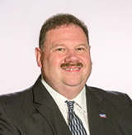
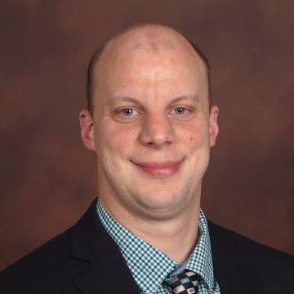
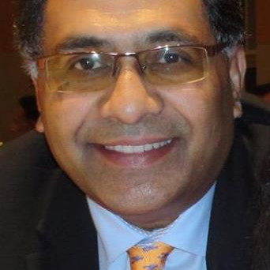
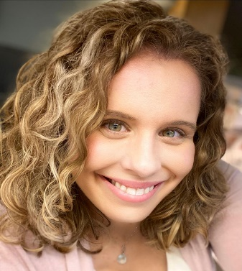
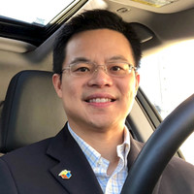

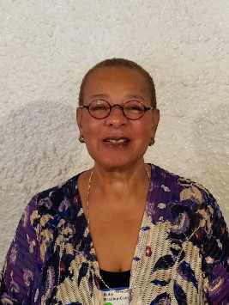
2021 Board Members
PMI Montgomery County, MD Chapter Board
Charlie Geis - President
Gene Egry - VP, Finance
Matt Lowy - VP, Communications
Manoj Singh - VP, Education*
Sandy Powell - VP, Membership
Ruby Bradley-Cain - VP, Programs
Dr. Scott Chen - VP, Programs
Jim Steckel - VP, Special Projects
* Annotates new board officers for 2021-2022 term

Slide 4
UPCOMING ELECTIONS
Our annual Chapter Elections are upcoming with Electronic Ballots due out in early November.
Nomination e-form will be made available in late September. Consider nominating yourself or convincing a friend/peer
Positions up for re-election/nomination include
  President (Must have Chapter Officer Experience)
  Co-Vice President of Programs
  Vice President of Membership
  Vice President of Communications

Slide 5

$10 DINNER SPECIAL FOR MEMBERS ALL YEAR
*Nov – Free Dinner
We have returned to Face-to-Face meetings in May
Our November Member Appreciation Dinner will be free for all valid members!
Safety Protocols will be followed per County Guidance

Slide 6

PMIWDC SYMPOSIUM NOTICE
Our sister chapter PMI Washington D.C. (PMIWDC) will be holding their first National Capital Region (NCR) Virtual Symposium.
  Will include their 4 sister chapters (MontCo, Baltimore, Silver Spring, So. MD) and make registration available to them at the Member Price
  Symposium will be held on Wed & Thurs Sept 22nd/23rd from 0900 to 1530. 7.0 PDUs each day (Total of 14)

Slide 7
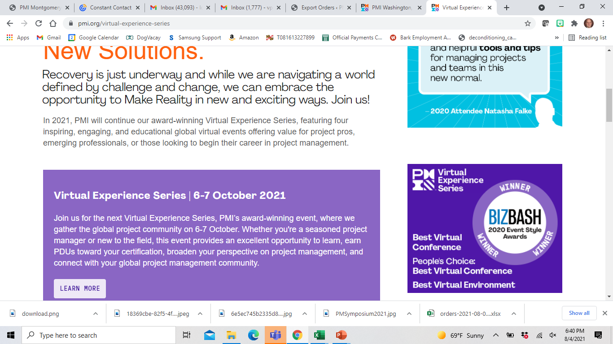

OCTOBER 2021
VIRTUAL EXPERIENCE SERIES
PMI is offering their October Virtual Experience Series for FREE!! (To valid members of course)
Will be held October 6th and 7th (Wed/Thurs) Noon to 6:00pm or Midnight to 6:00am
Keynote Speakers include the Time Magazine 2020 Kid of the Year Ms. Gitanjali Rao & Best Selling Author Mr. Peter Hinssen

Slide 8

OCTOBER 2021
SEMINARS WORLD
Seminars World - Virtual (PMI Global Event) runs from 11 – 14 October
Speakers include friends of the Chapter Dr. Josef Martens (Influence on Projects), Leadership Techniques (Maintaining flexibility to ensure PM success) and Mr. Bruce Gay (Integration Of Design Thinking)

Slide 9








Our Education Partners are still in business and doing Amazing Things!

Slide 10
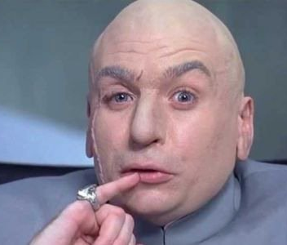


Our Featured Speaker for this evening is Mr. Matt Lowy (PMP, PMI-SP, MBA, ITIL Practitioner, CSM, CQA, CMQ-OE), your Current Chapter VP of Communications
Internationally known crime genius who has rivaled Austin Powers for decades
Spokeperson for Six Flags in the 90s/2000s
One of TV Guide’s 50 Greatest Cartoon Characters of all time!

Slide 11

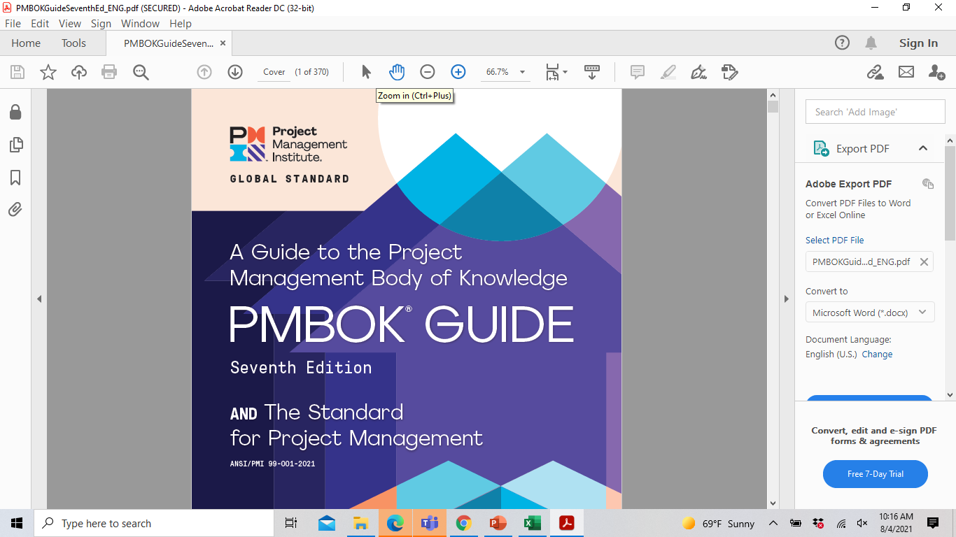
The 7th edition of the PMBoK IS HERE!! What do you need to know ?
Mr. Matt Lowy (PMP, PMI-SP)
Notes:
10 pages of contributors… I am not one of them

Slide 12
4 YEARS…. NOT SO LONG AGO
Back when the 6th edition was released in 2017,
  We wore masks on Halloween or if our job required it
  A Marvel movie was leading the domestic Summer Box Office (Spiderman: Homecoming) (Black Widow holding that title now with $170M)
  ONLY 65,000 companies worldwide were using Zoom! ☺ (Now 467,100 companies use the collaboration tool)

Slide 13
THE 34 YEAR OLD STANDARD
Since the 1st Project Management standard came out from PMI in 1987, three Business Process function standards have stayed consistent
IMPROVEMENTS TO PROCESS CAN BE MADE TO MAXIMIZE EFFICIENY AND MINIMIZE THREATS
PERFORMANCE AGAINST PROCESS CAN BE ASSESSED
COULD BE DOCUMENTED

Slide 14
THE TIMES THEY ARE A-CHANGING
Are we still working in a deliverable-process minded environment??
AGILE PROJECT MANAGEMENT
EVERYTHING BECOMING A PROJECT
IS ANYONE READING YOUR DOCUMENTATION’?

Slide 15
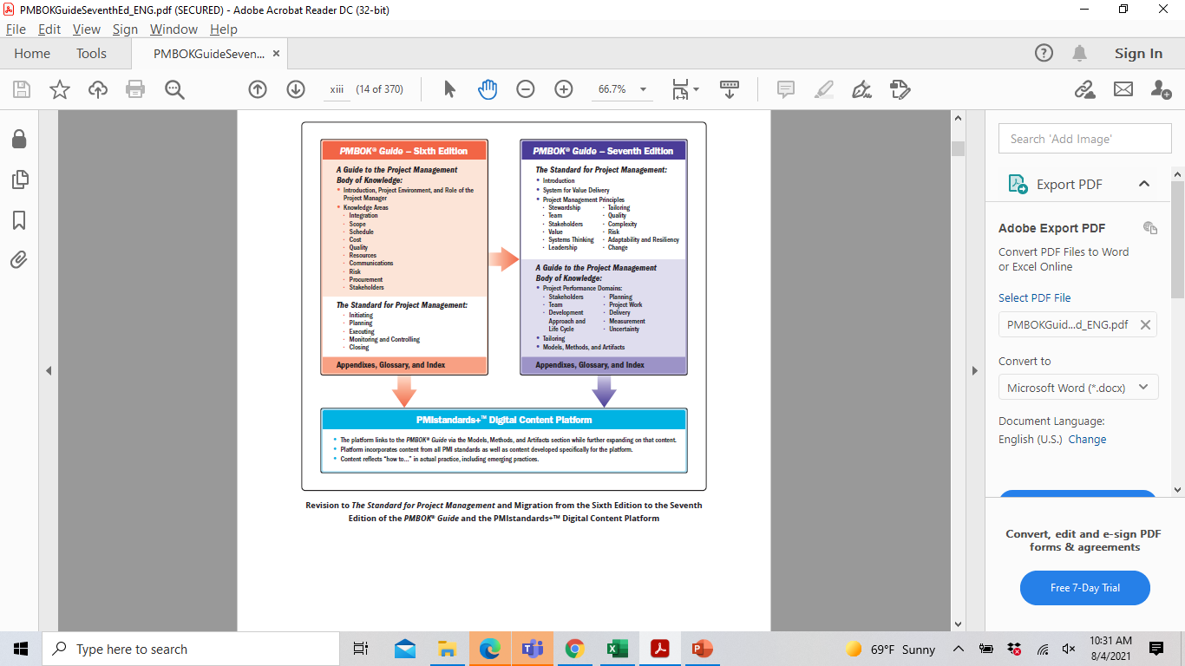
SHIFT IN IDEALOGY

Slide 16

“You should never ever doubt what others are unsure about”
- Willy Wonka

Slide 17
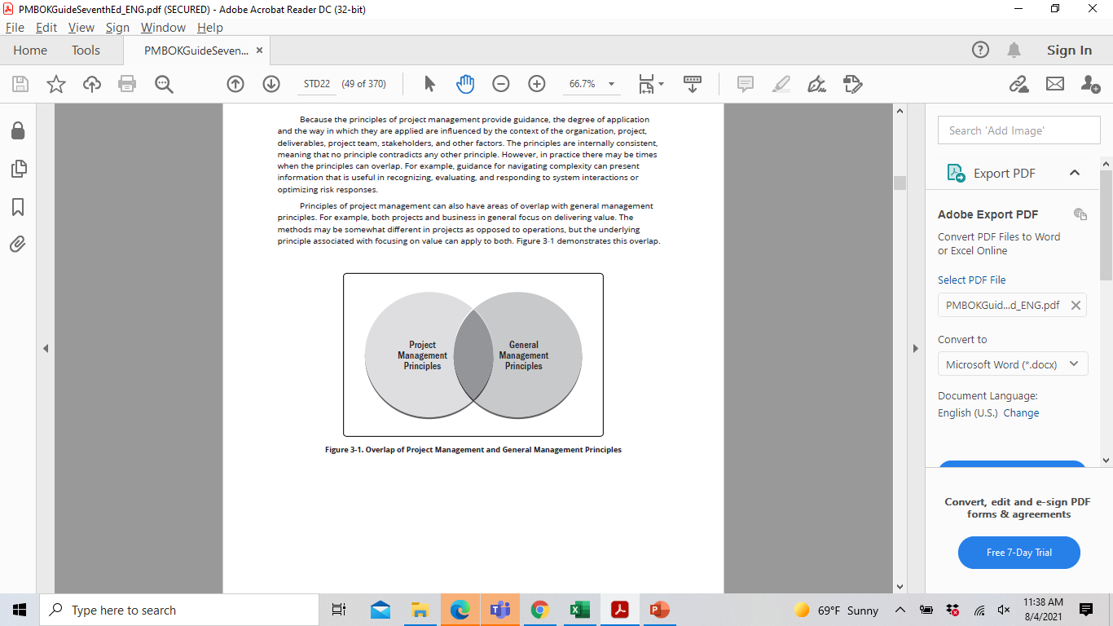
PRINCIPLES OF PROJECT MGMT.
(Replacement for Knowledge Areas)
Project Mgmt. Principles are not prescriptive in nature
Intended to guide behavior of people involved in your projects
Principles were developed by global community of project practioners
PMI’s new PM Principles WILL OVERLAP with
General Management principles…. And THAT IS OK!

Slide 18
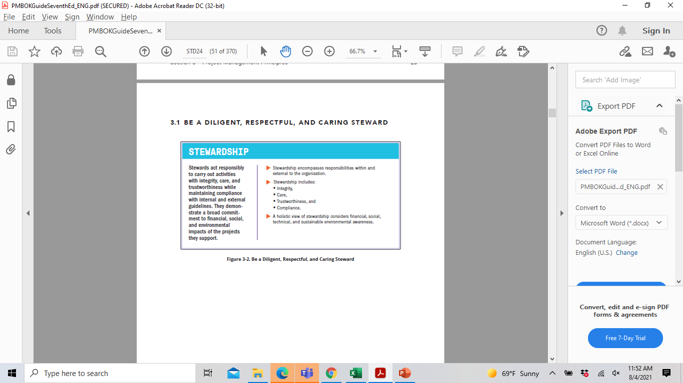
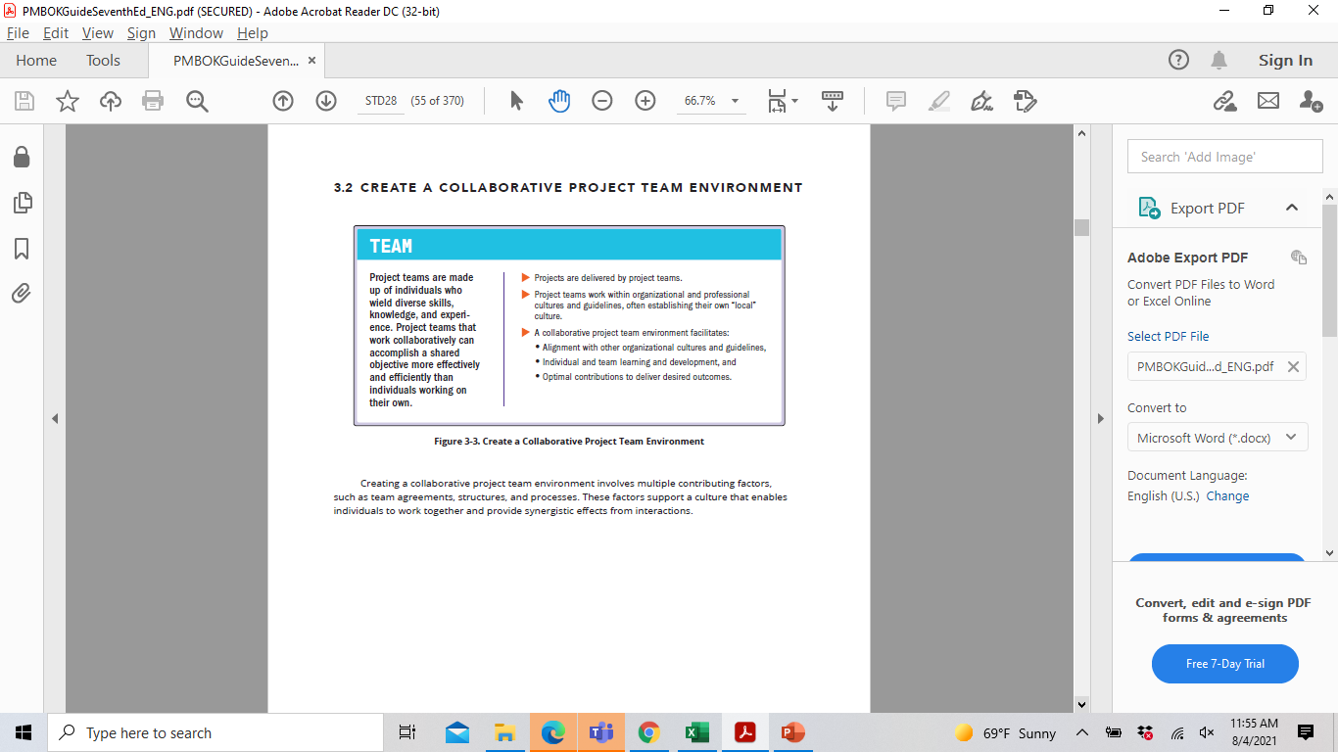
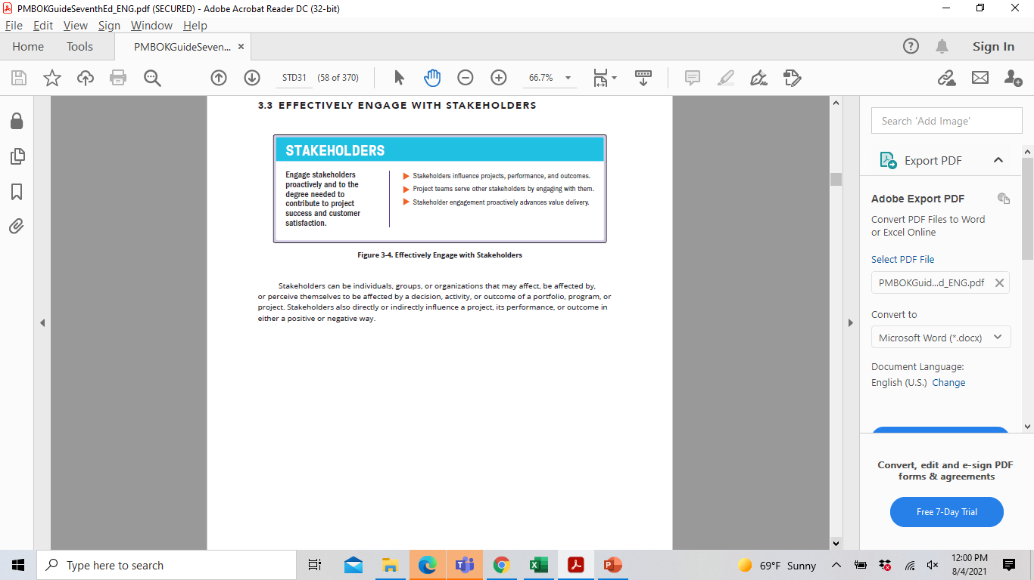
PRINCIPLES GROUPING #1 - TEAMS

Slide 19
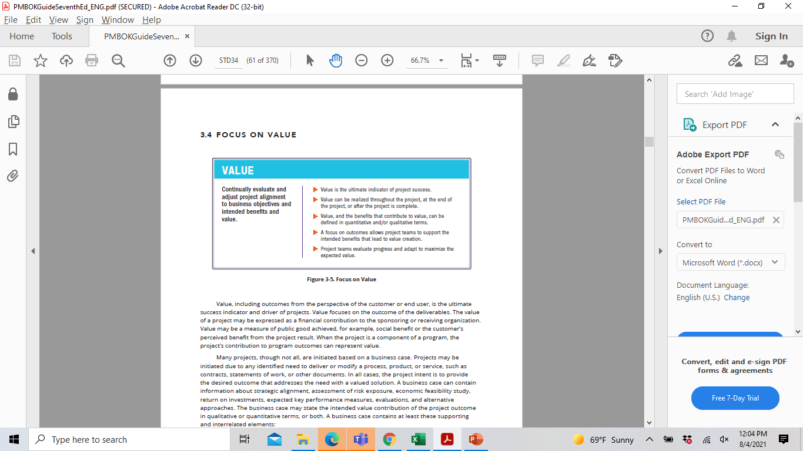
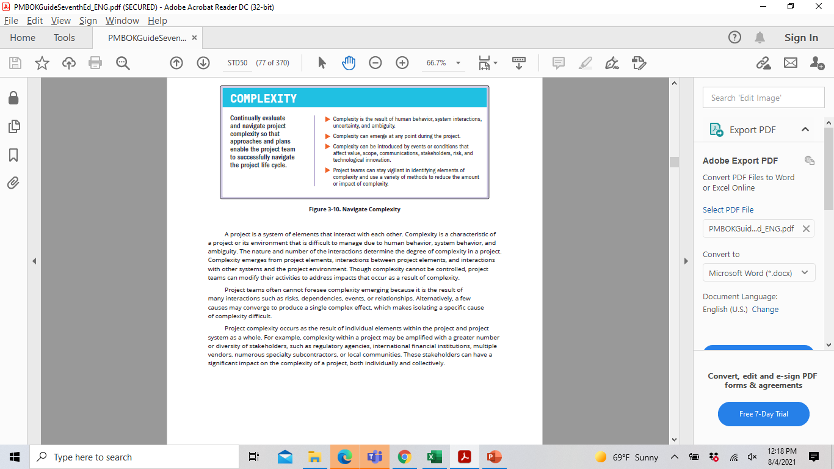
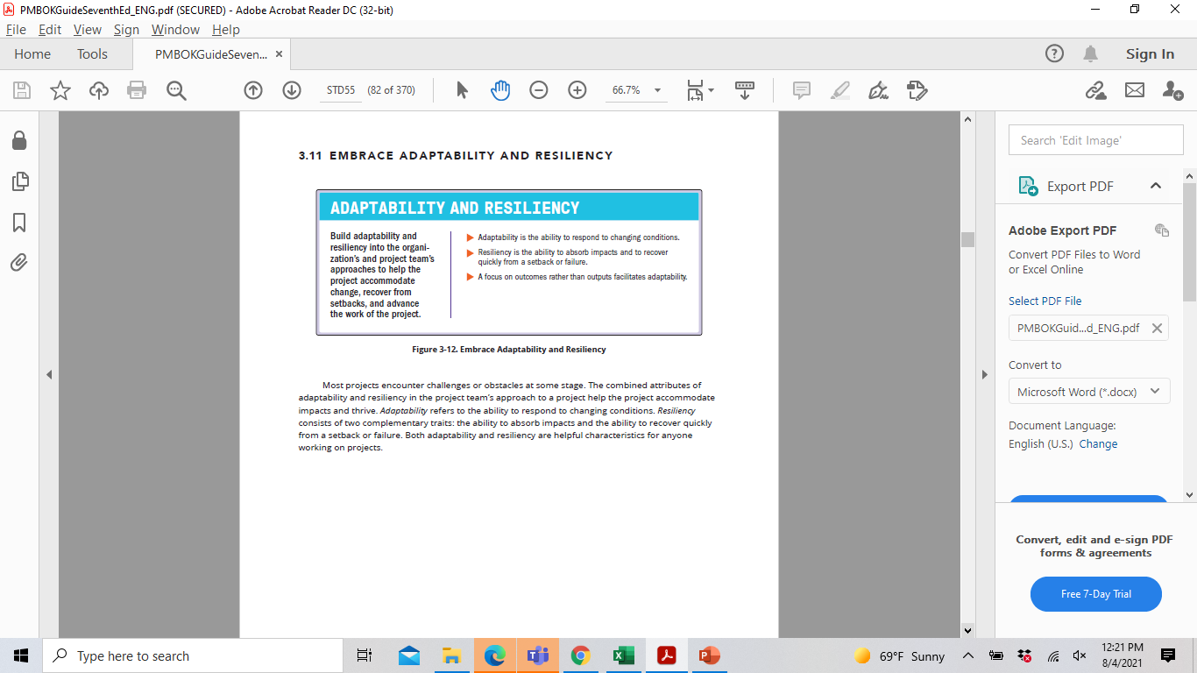
PRINCIPLES GROUPING #2 – CHARACTERISTICS

Slide 20
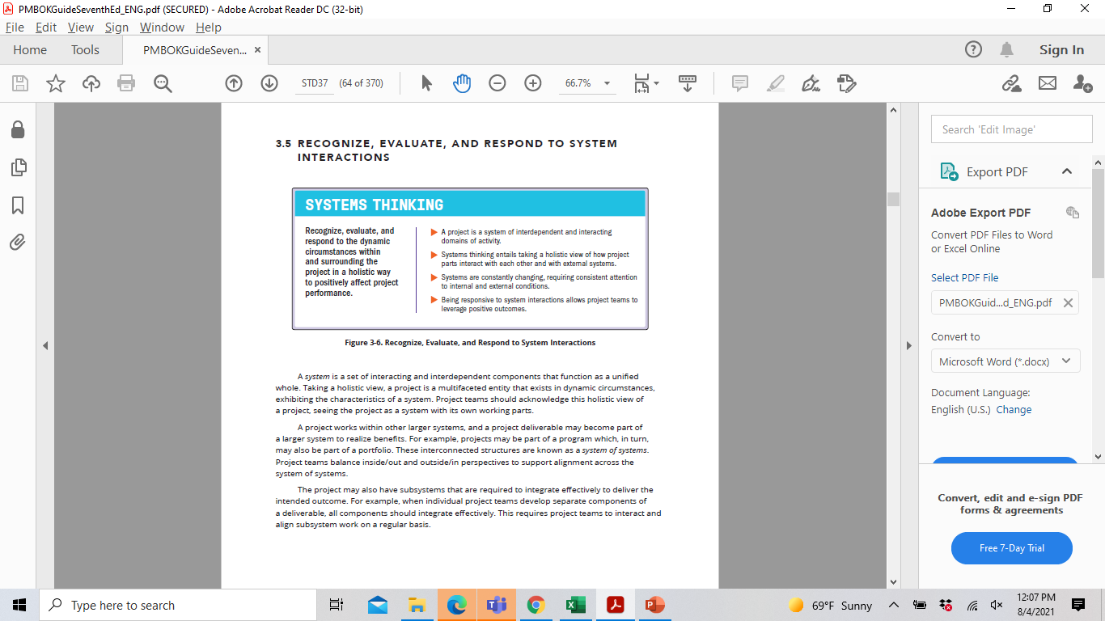
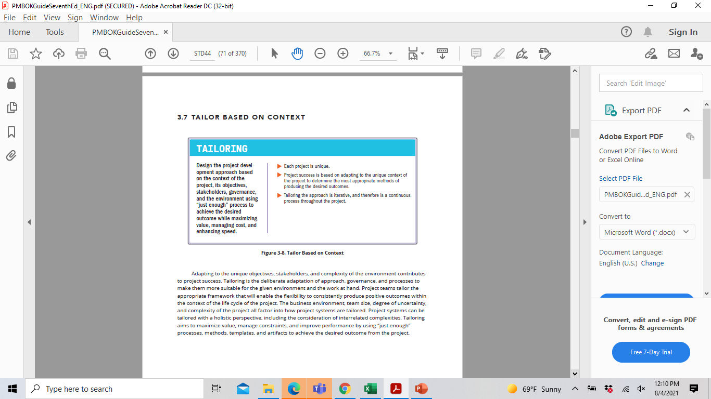
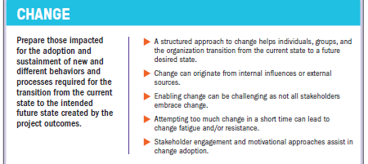
PRINCIPLES GROUPING #3 - TECHNIQUES

Slide 21
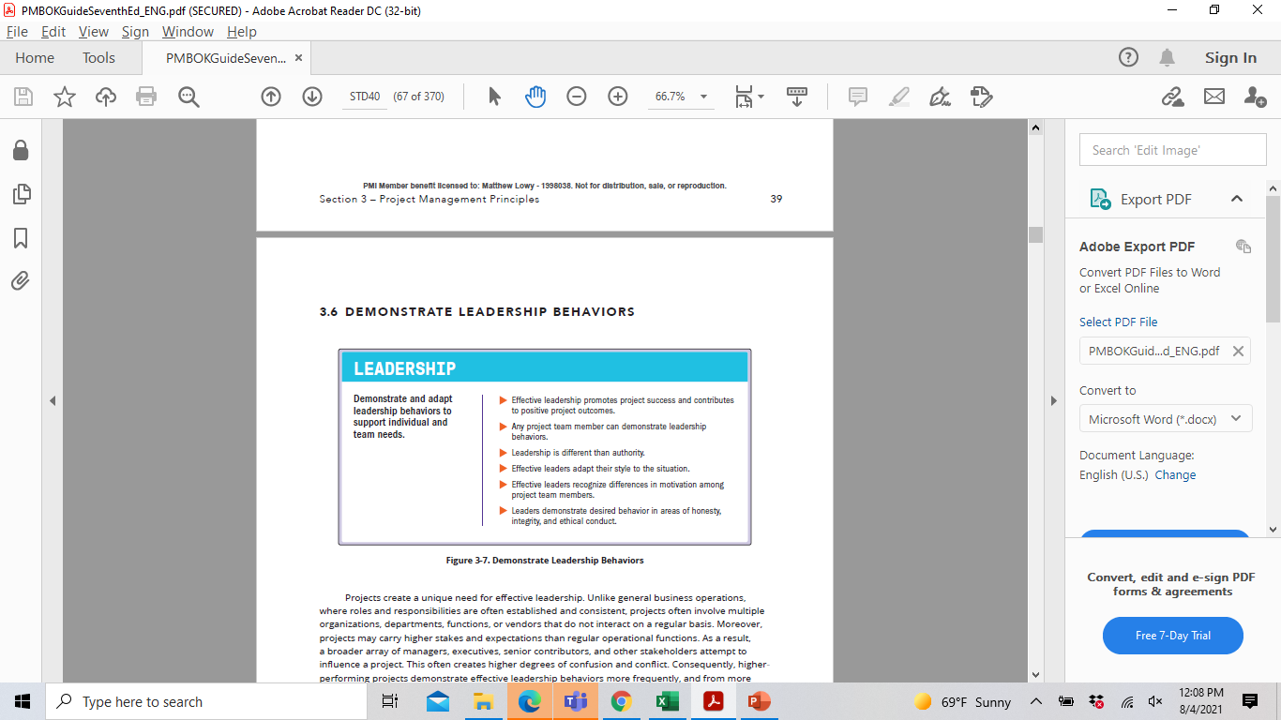
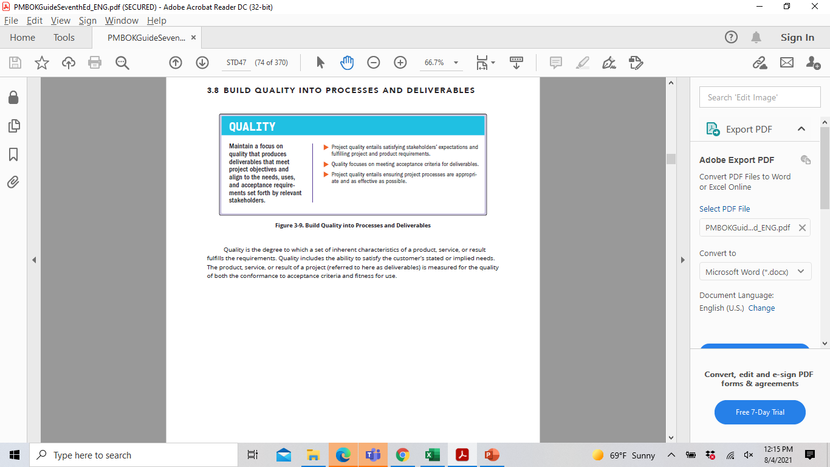
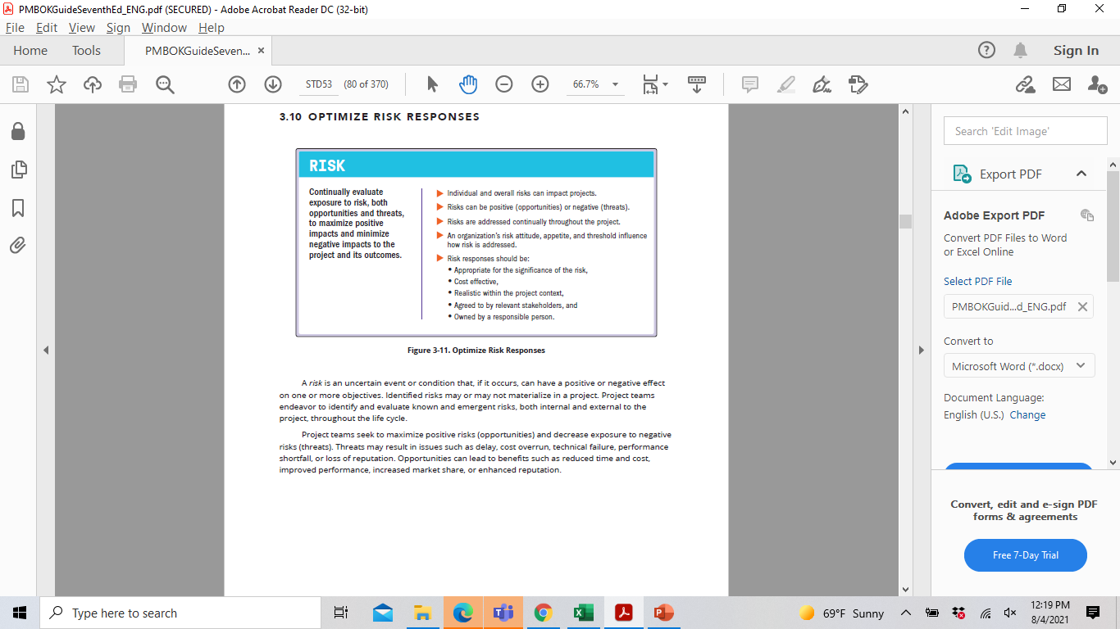
PRINCIPLES GROUPING #4 – SUCCESS KEYS

Slide 22
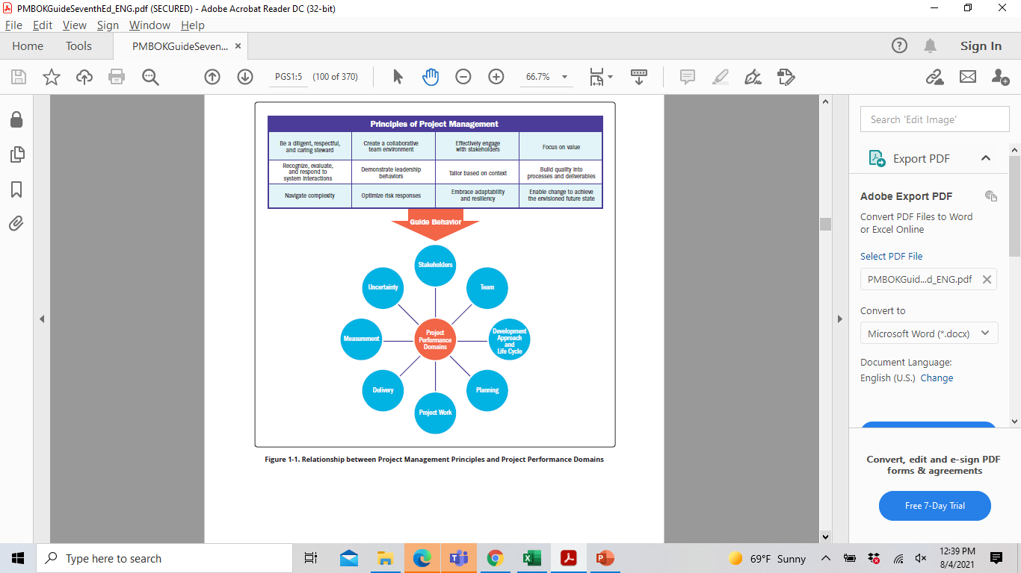
Principles guide behavior that will influence success of the (8) Project Performance Domains
Differing from the (5) process model, the domains can work concurrently

Slide 23
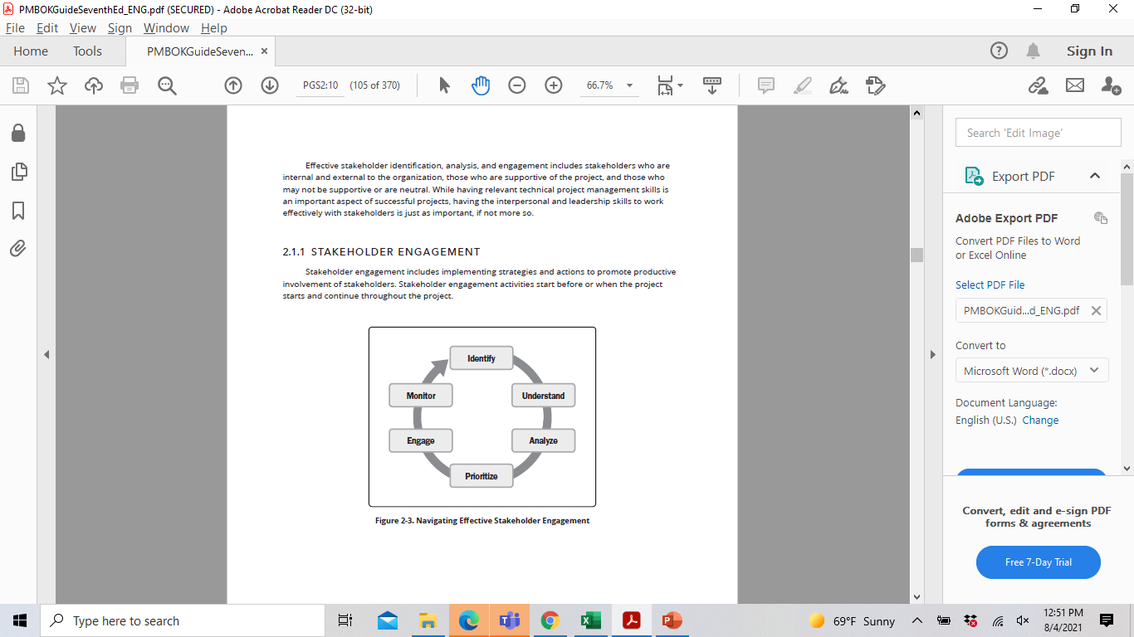
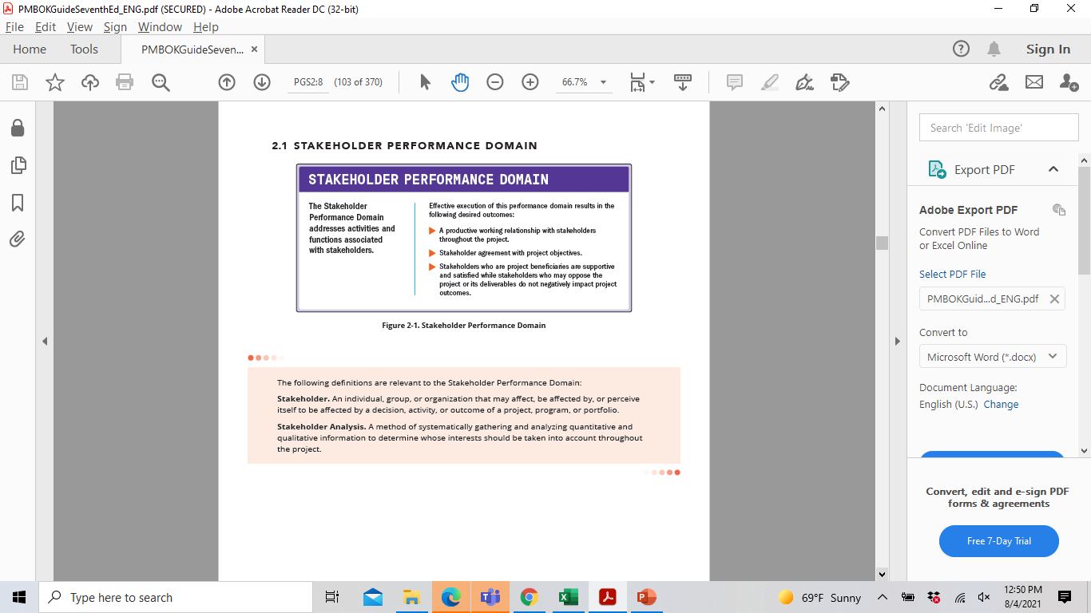
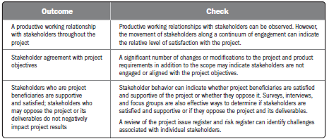
STAKEHOLDER PERFORMANCE DOMAIN

Slide 24
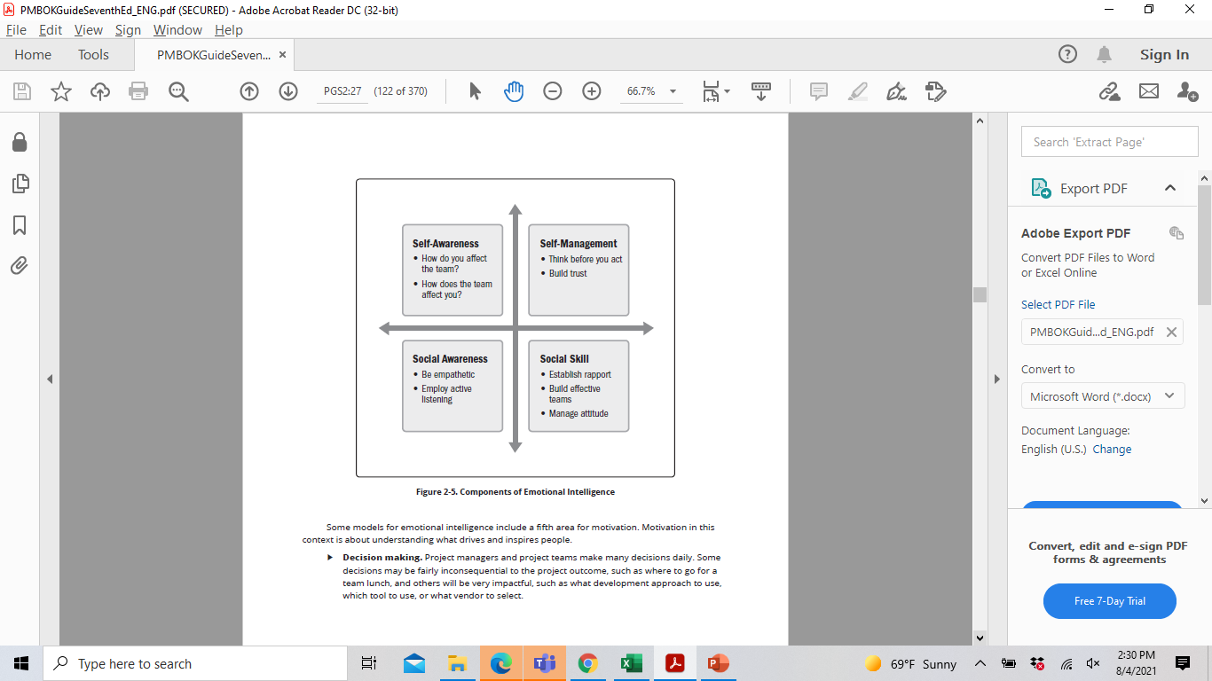
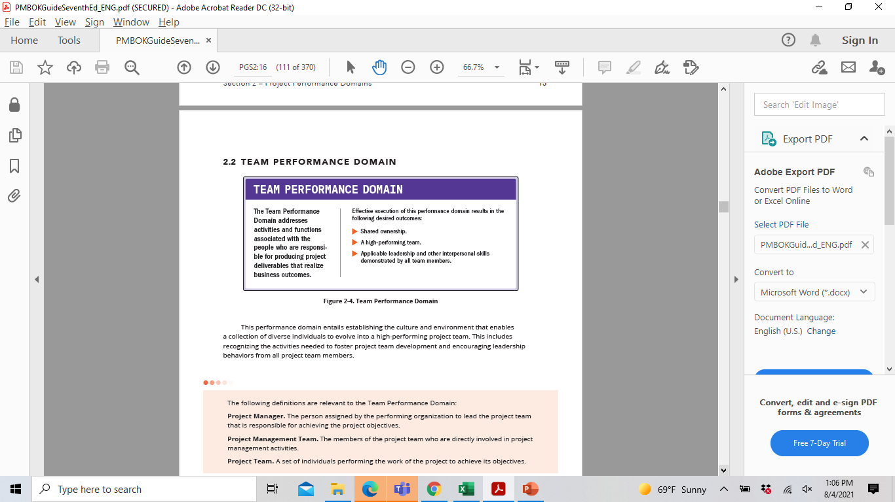
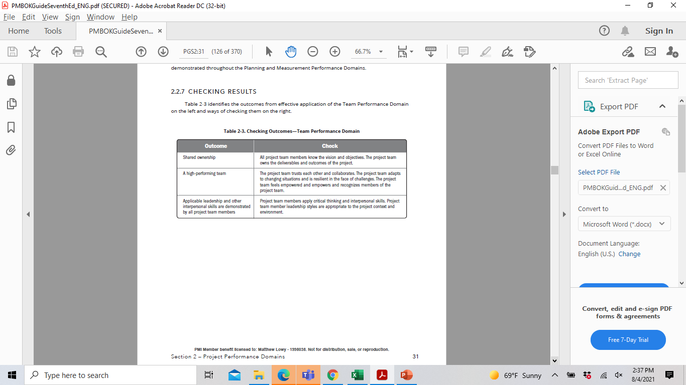
TEAM PERFORMANCE DOMAIN

Slide 25
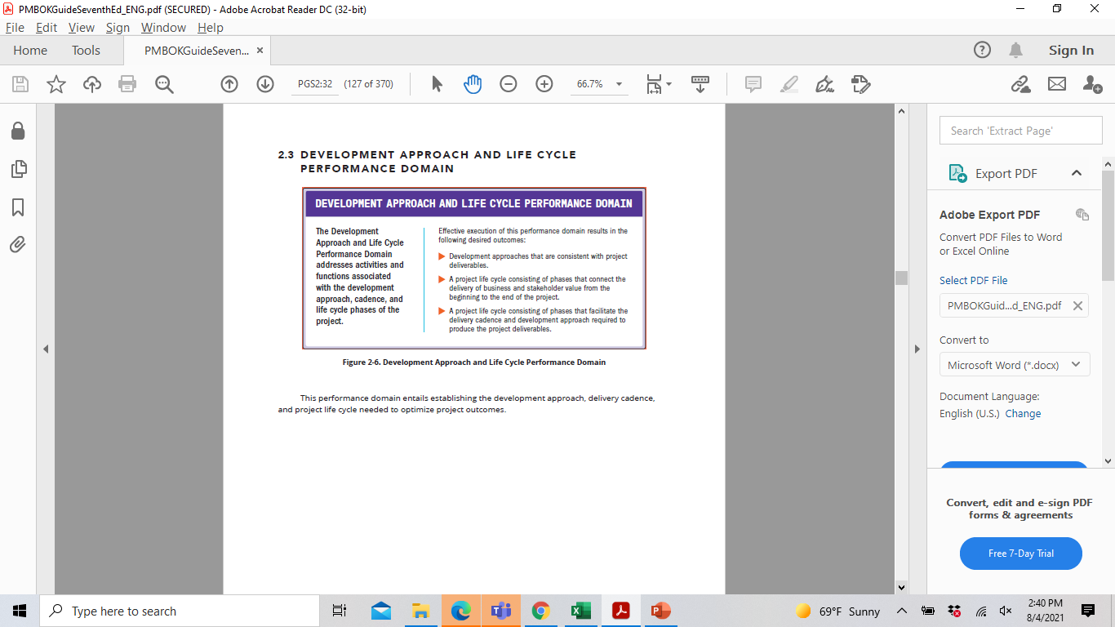
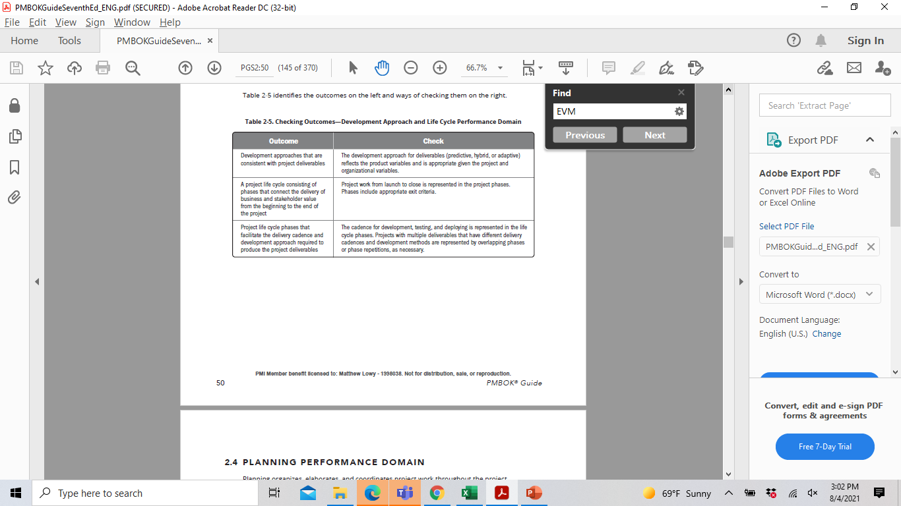
DEVELOPMENT APPROACH & LIFE CYCLE PERFORMANCE DOMAIN

Slide 26
DEVELOPMENT APPROACHES
APPROACH TYPE | DEFINITION
PREDICTIVE | When project & product requirements can be defined/analyzed at START OF PROJECT (Waterfall)
ADAPTIVE | Requirements are uncertain and subject to high levels of change throughout project
HYBRID (ITERATIVE) | Requirements being clarified (When MVP is your goal)
HYBID (INCREMENTAL) | Deliverables produced through iteration releases (Agile)

Slide 27
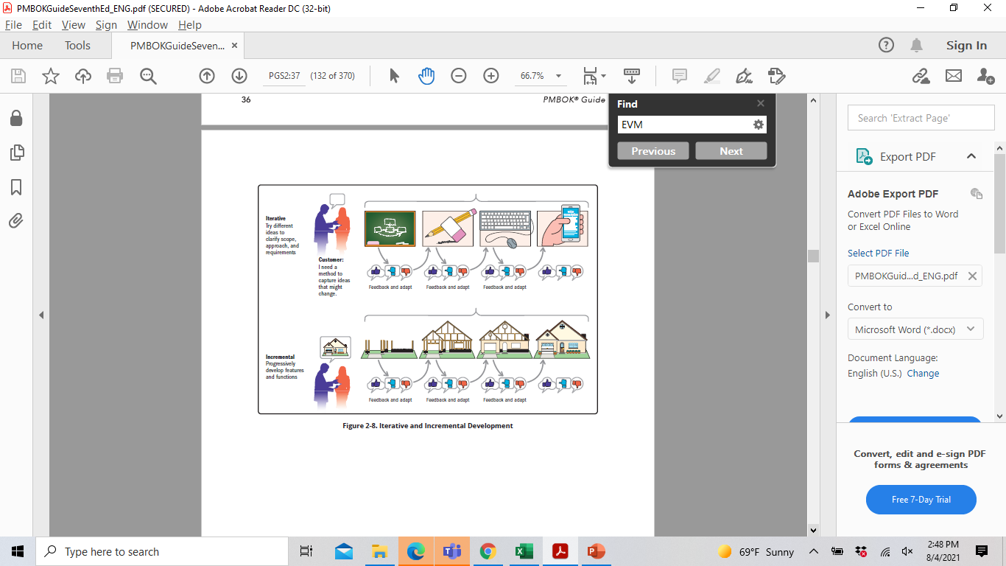
ITERATIVE & INCREMENTAL DEVELOPMENT
Hybrid Development =
Combination of adaptive & predictive approaches
Hybrid solutions will either have iterative or incremental development

Slide 28
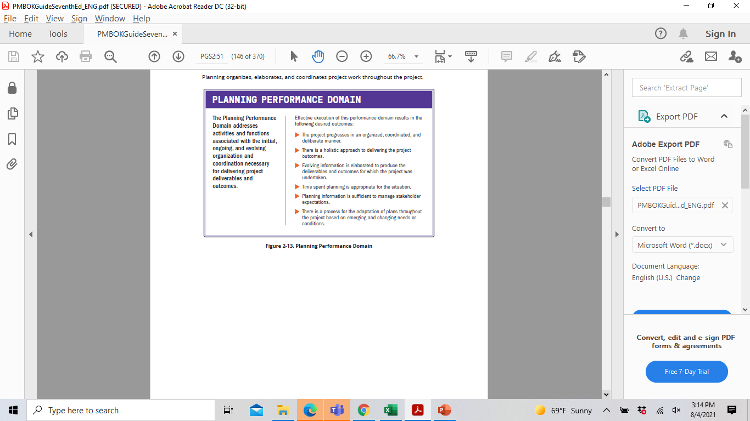
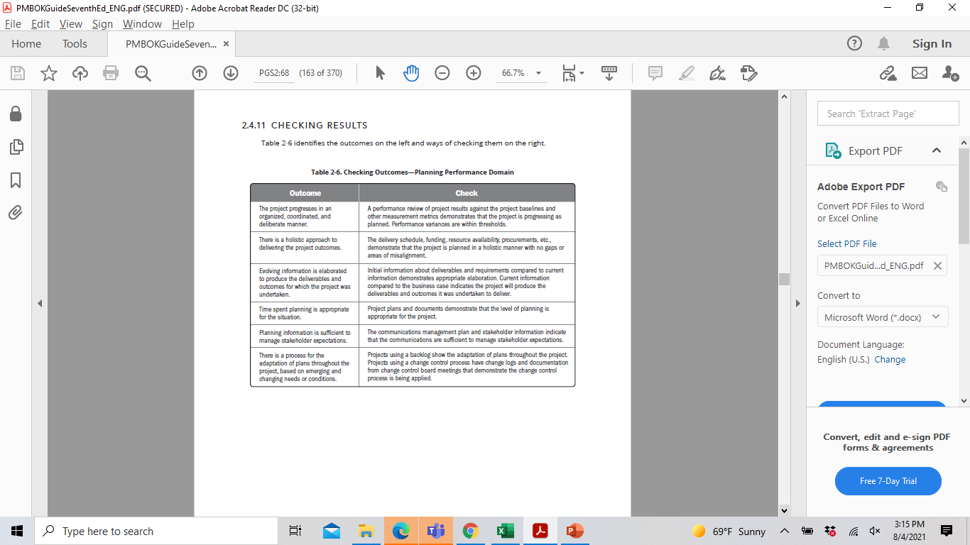
PLANNING PERFORMANCE DOMAIN

Slide 29
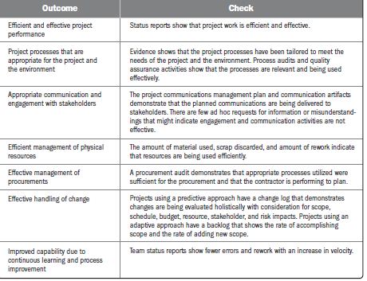
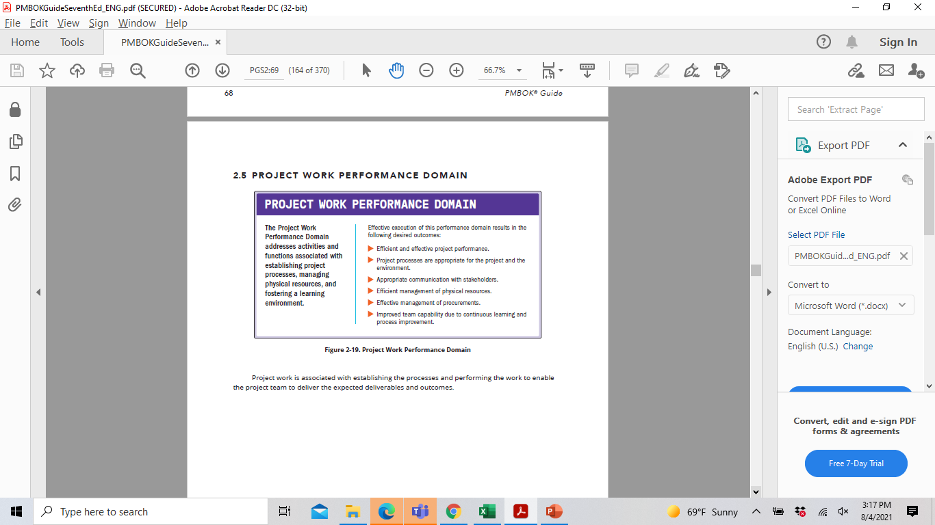
PROJECT WORK PERFORMANCE DOMAIN

Slide 30
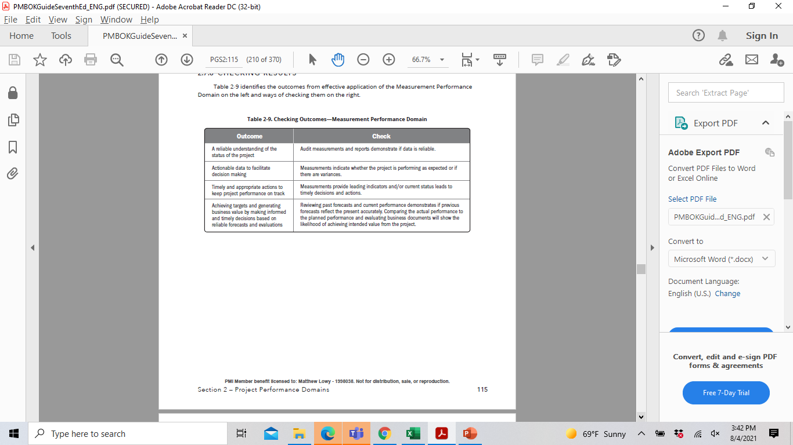
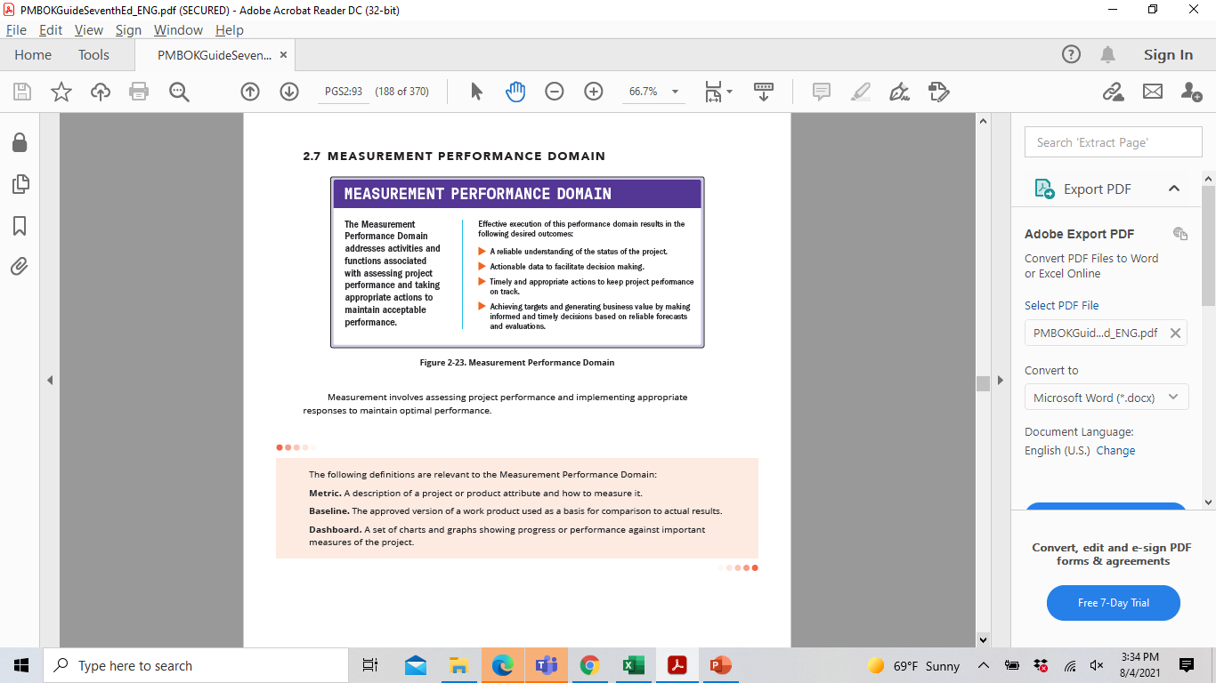
MEASUREMENT PERFORMANCE
DOMAIN

Slide 31
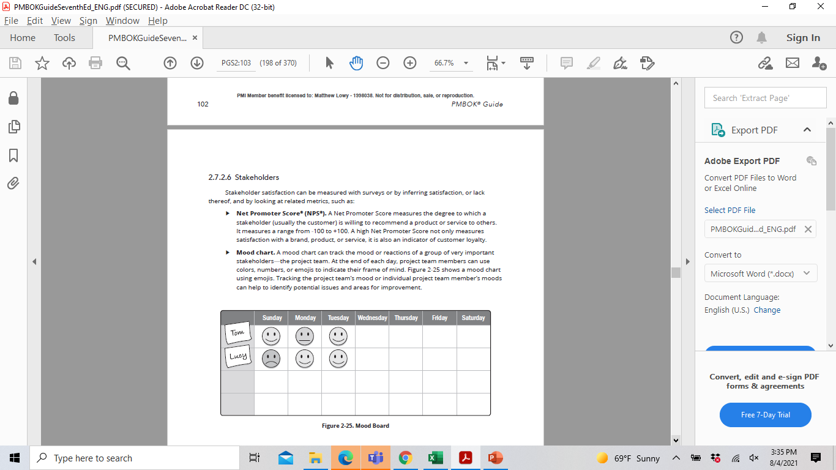
STAKEHOLDER SATISFACTION
Why wait until a post-project 360 to assess if your Project Team is happy… Use a Mood Board!

Slide 32
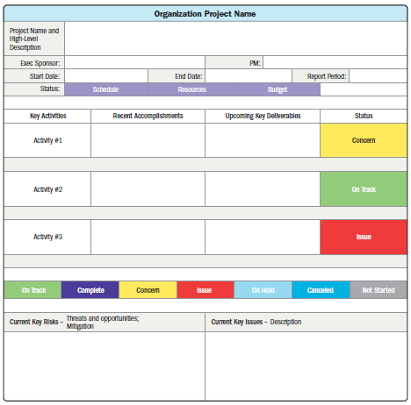
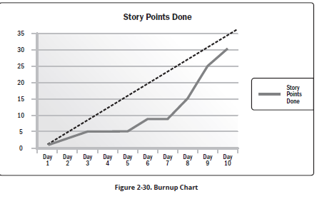
ENTERING THE 21st CENTURY
DASHBOARDS!! Brief live from your solution… not PPT slides
Agile User Story Points
Burnup Charts

Slide 33
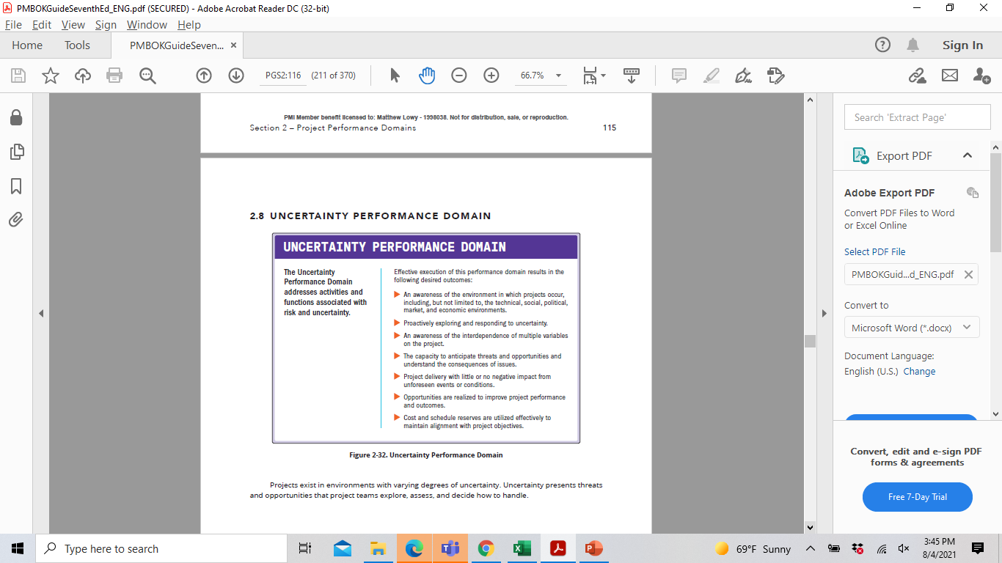
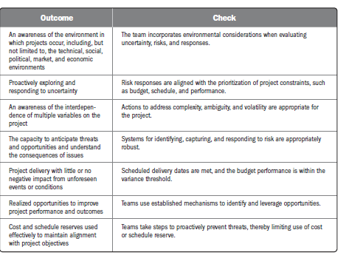
UNCERTAINITY PERFORMANCE
DOMAIN

Slide 34
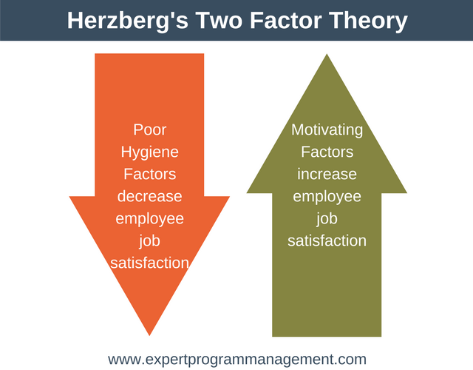
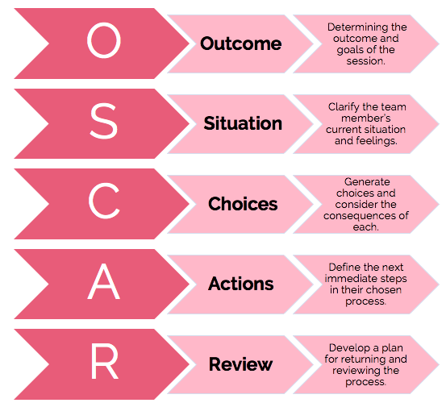
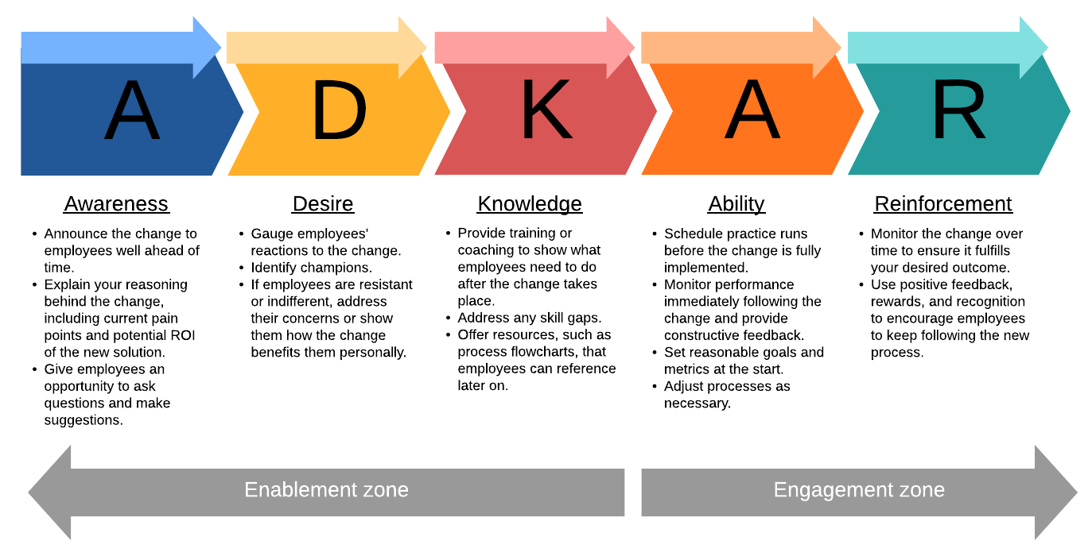
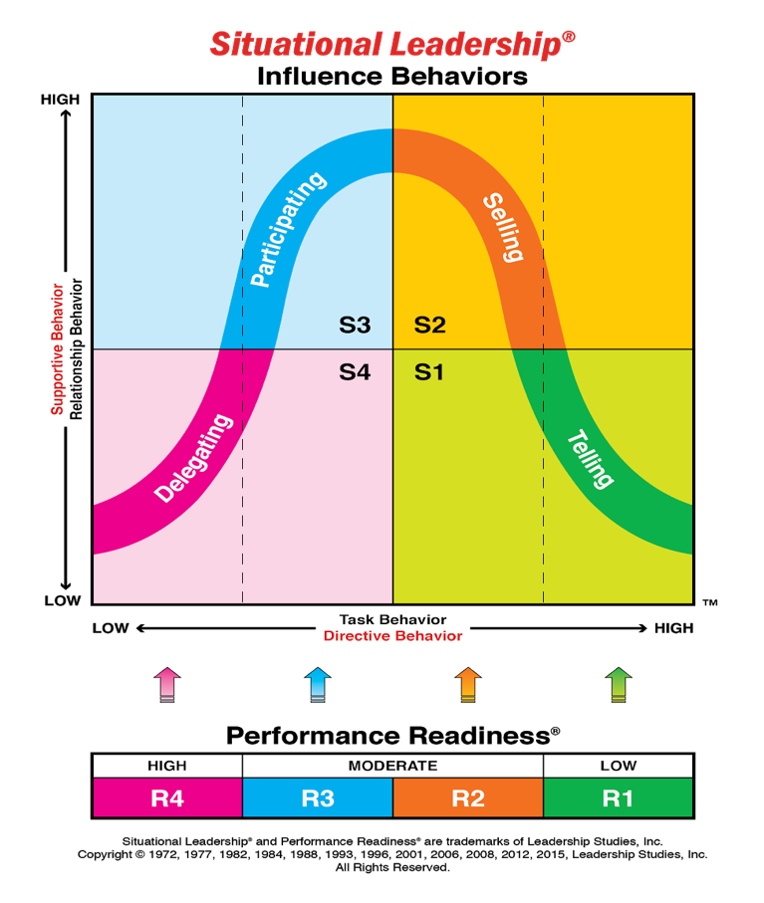
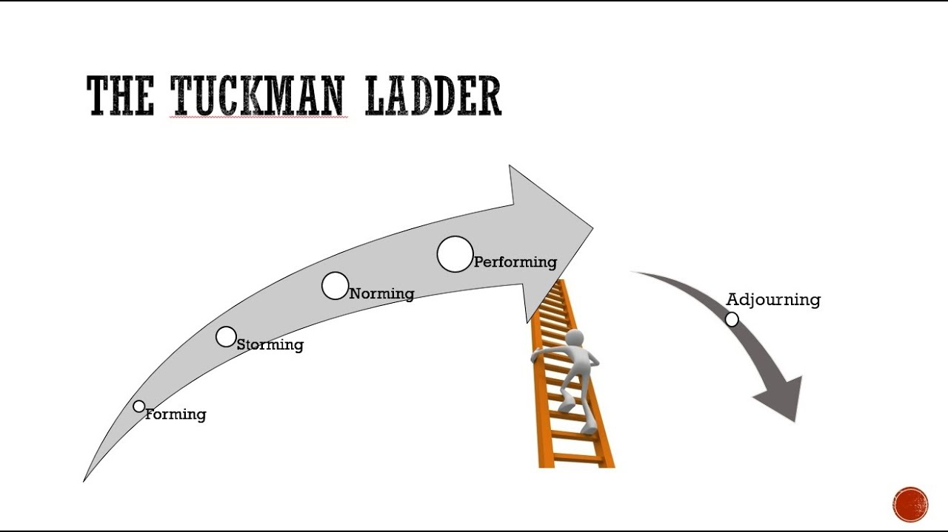
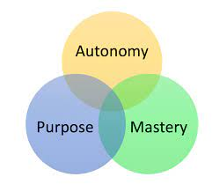


MODELS GALORE…..

Slide 35

A MODEL FOR EACH PERFORMANCE DOMAIN!

Slide 36

AND METHODS FOR EACH P.DOMAIN!

Slide 37

PMISTANDARDS+ DIGITAL CONTENT
Free to PMI Members . Must register separately for access
  Access to standards & guides
  Case Studies available for review
  Templates based on approaches/industry of choice
  A complement to Projectmanagement.com, not an alternative
  https://standardsplus.pmi.org/

Slide 38
IMPACT ON PMP CERTIFICATION TESTING
In Jan 21, the PMP test changed to focus on 3 domain areas
  People
  Process
  Business Environment
    Exam became very agile & hybrid approach heavy
    Exam Outline was just as important a review as PMBoK 6th ed.
    Online proctored exam option is now offered
A PMP (and other exam) update based on PMBoK 7th Edition is expected in 2022/2023 but no declarative dates have been given

Slide 39
WHAT TO DO NOW?
Download it and add it to your OneDrive, Google Drive, etc.
Continue to lead and manage projects as you have …. The change in the PMBoK does not impact that!
Use this 7th edition as a reference & tool to expand your skillset and perspective
Pick one or two of the models and see how they can add value to your work!

